Slide 1

Building GDPR-Compliance In: From Requirements to Software Evolution
Liliana Pasquale
liliana.pasquale@ucd.ie
lpasquale.github.io
Notes:
Good afternoon
My name is Liliana pasquale I am associate professor at UCD and funded investigator at Lero
In this talk I will discuss our work on building software systems that are compliant with the GDPR.
Our approach aims to identify compliance requirements from data protection principles and ensure compliance by evolving the architecture (UML sequence diagrams) of existing software systems.

Slide 2
Outline
Intro to GDPR Compliance
Our Approach to Support Software Compliance
Gap Analysis
Evolution
Evaluation
Discussion & Future Work

Slide 3
Intro to GDPR Compliance
Our Approach to Support Software Compliance
Gap Analysis
Evolution
Evaluation
Discussion & Future Work

Slide 4
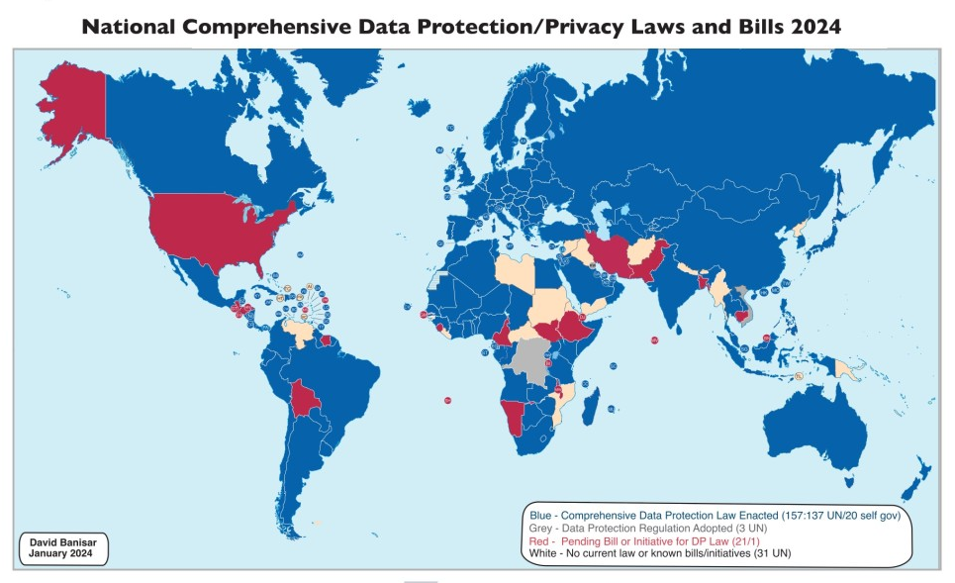
Europe – General Data Protection Regulation (GDPR)
China – China’s Personal Information Protection Law
California – California Consumer Privacy Act (CCPA)
New Zealand – New Zealand Privacy Act
Brazil – General Data Protection Law (LGPD)
Notes:
Following the enforcement of the EU General Data Protection Regulation (GDPR) in 2018, new and revised data protection laws have come into effect in several countries worldwide (International Association of Privacy Professionals, 2024), such as the Brazilian General Data Protection Law (LGPD) (Brazilian Federal Government, 2018), the California Consumer Privacy Act (CCPA) (California State Legislature, 2018), the New Zealand Privacy Act (New Zealand Parliamentary Counsel Office, 2020), and China’s Personal Information Protection Law (People’s Republic of China, 2020).
These laws seek to ensure that best practices are followed by organizations when processing personal data.
Such a rapidly changing regulatory environment requires organizations to evolve their software systems to integrate technical controls that can fulfill the new obligations imposed by these privacy laws.

Slide 5


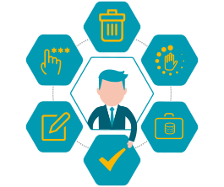

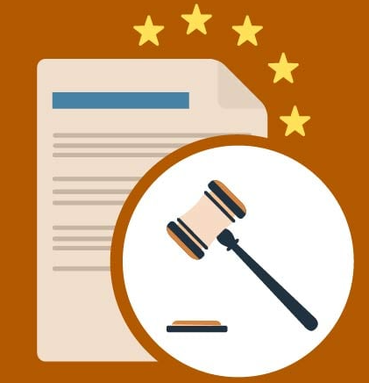

General Data Protection Regulation (GDPR)
Extraterritorial Scope
Personal Data Definition
Data Subject Rights
Lawful Basis for Processing
Data Protection By Design and By Default
Data Breach Notification
Notes:
Extraterritorial Scope:
The GDPR applies to all companies that process the personal data of individuals residing in the EU/EEA, regardless of the company's location.
Personal Data Definition:
Personal data is defined broadly and includes any information relating to an identified or identifiable natural person (data subject). This can include names, identification numbers, location data, online identifiers, and more.
Data Subject Rights:
The GDPR grants several rights to individuals, including:
Right to Access: Individuals can request access to their personal data and obtain information about how it is being processed.
Right to Rectification: Individuals can request corrections to inaccurate or incomplete personal data.
Right to Erasure (Right to be Forgotten): Individuals can request the deletion of their personal data under certain conditions.
Right to Restriction of Processing: Individuals can request the restriction of processing their personal data under certain conditions.
Right to Data Portability: Individuals can request their data in a structured, commonly used, and machine-readable format and transfer it to another controller.
Right to Object: Individuals can object to the processing of their personal data, including for direct marketing purposes.
Right to Avoid Automated Decision-Making: Individuals have the right not to be subject to decisions based solely on automated processing, including profiling, which produces legal effects or similarly significant effects.
Lawful Basis for Processing:
Organizations must have a lawful basis to process personal data. The lawful bases include:
Consent of the data subject.
Performance of a contract.
Compliance with a legal obligation.
Protection of vital interests.
Performance of a task carried out in the public interest or in the exercise of official authority.
Legitimate interests pursued by the controller or a third party, except where overridden by the interests or fundamental rights and freedoms of the data subject.
Data Protection by Design and by Default:
Organizations are required to implement data protection principles into the design of their systems and processes (Privacy by Design) and to ensure that, by default, only the necessary personal data is processed (Privacy by Default).
Data Breach Notification:
Organizations must notify the relevant supervisory authority of a data breach within 72 hours of becoming aware of it, unless the breach is unlikely to result in a risk to the rights and freedoms of individuals. In some cases, affected individuals must also be notified.

Slide 6


… But Data Breaches Still Persist
2024 – Uber transferred European’s drivers’ personal data to US servers without adequate safeguards.
2023 –“View As” feature was used to steal access tokens, gaining control over user accounts.
Notes:
However, data breaches persist mainly due to the inadequate implementation or lack of robust technical controls in modern software systems (New Zealand Government, 2020). This demonstrates that, although security and privacy are intertwined, they are both required to comply with data protection (Herzog, 2016).
Uber's Data Transfer Violations In 2024, Uber was fined €290 million by the Dutch Data Protection Authority for transferring European drivers' personal data to U.S. servers without adequate safeguards, violating GDPR. The sensitive data included account details, taxi licenses, location data, photos, payment details, identity documents, and, in some cases, criminal and medical data. Uber plans to appeal the fine, calling it "flawed" and "completely unjustified.
lation (GDPR). Notable incidents include:
1. Meta's 2018 Data Breach In 2023, Meta, the parent company of Facebook, was fined €251 million by Ireland's Data Protection Commission for a 2018 breach that exposed millions of user accounts. Attackers exploited vulnerabilities in Facebook's "View As" feature to steal access tokens, gaining control over user accounts.

Slide 7


Inadequate Implementation of Security and Privacy (Priv&Sec) Controls
Insufficient Security & Privacy Skillset
[Hadar2018, DiasCanedo2020]
Limited guidance on which priv&sec controls to implement and how
[Martin2018]
Notes:
Engineers experience difficulties in implementing security and privacy requirements
Software engineers, who are often tasked to achieve compliance in software systems, may not have sufficient expertise to develop appropriate technical privacy and security controls (hereafter referred to as priv&sec controls) (Hadar et al., 2018, Dias Canedo et al., 2020).
Although roadmaps (Mcadam, 2017, Deloitte, 2017), checklists (DPC Ireland, 2017, Isaca, 2017), and processes (Coleti et al., 2020, Guamán et al., 2021) have been proposed to support GDPR compliance, they need to provide explicit guidance about which priv&sec controls to implement and how.

Slide 8
Intro to GDPR Compliance
Our Approach to Support Software Compliance
Gap Analysis
Evolution
Evaluation
Discussion & Future Work

Slide 9
Objective
Evolve software systems to ensure GDPR compliance in a more systematic (and possibly automated) way.

Slide 10
Novelty
Evolve software systems to ensure GDPR compliance in a more systematic (and possibly automated) way.
Roadmaps, checklists and processes to support GDPR compliance
Proprietary and detached from software engineering practices [Martin&Kung2018]
Modelling and elicitation of legal requirements
Do not focus on how to select and implement priv&sec controls
Privacy-by-design approaches
Do not consider how to integrate priv&sec controls in the system architecture
Notes:
Several commercial solutions have been developed to help organizations achieve compliance with the GDPR, such as proprietary roadmaps (Mcadam, 2017, Deloitte, 2017, SAS, 2018), off-the-shelf privacy technology tools (IAPP, 2022), and self-assessment checklists to evaluate the level of GDPR-readiness of an organization (DPC Ireland, 2017, Isaca, 2017). However, these solutions are proprietary and cannot be afforded by small organizations. They are also detached from software engineering practices (Martin and Kung, 2018).
e, existing solutions do not focus on how to automatically select priv&sec controls to ensure GDPR compliance and apply these controls to the design artifacts of software systems.
ISO 29100 Privacy Framework

Slide 11
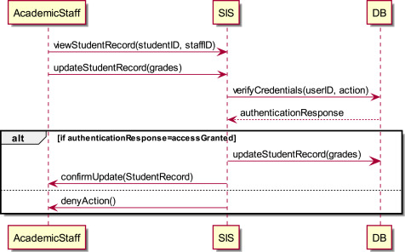

Example – Student Information System
Dispute concerning incorrect grade
[Ayala-Rivera2024]
Accuracy Data Protection Principle
Notes:
Our example involves a Student Information System (SIS) used in a university (UniXYZ) to process student data for academic purposes. A possible data flow is shown in the diagram in Fig. 1. An academic staff requests the SIS to change a student’s grade. Next, the SIS verifies the credentials of the academic staff in the database (DB). If authorized, the SIS modifies the student’s grade and confirms the change. Otherwise, it notifies the academic staff that the request was denied.
A problematic situation might arise if a module coordinator opens a dispute about an incorrect grade (because it is different from the grade they originally proposed), but the SIS does not log enough data to prove why and who changed the grade to support a grade rectification.
This violates the Accuracy DPP, which claims that “every reasonable step must be taken to ensure that personal data that are inaccurate ... are erased or rectified without delay”. A possible priv&sec control to fix this issue is to log any processing activity performed to a student record, to support postmortem event reconstruction and justify grade rectification.

Slide 12
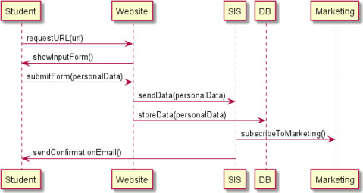
Example – Student Information System
Personal info reused for marketing purposes without consent
[Ayala-Rivera2024]
Lawfulness, Fairness and Transparency DPP
Purpose Limitation DPP
Notes:
following is another example of a possible GDPR violation in UniXYZ’s SIS. Let us suppose the SIS fails to provide students with a clear consent mechanism and instead assumes their implicit consent for reusing their information for non-directly teaching-related activities like automatically being added to marketing communications when registering to a course (as illustrated in Fig. 2).
This scenario would involve two different GDPR non-compliances: On the one hand, personal information is reused for marketing without notifying individuals or obtaining their explicit consent to use it in this way. This violates the Lawfulness, Fairness, and Transparency DPP as organizations must be transparent about how the collected data will be used and also give the individuals the option to provide informed consent using affirmative action. The scenario also violates the Purpose Limitation DPP, as such information reuse is incompatible with the consent initially provided by the individuals to process their information for teaching-related activities.

Slide 13
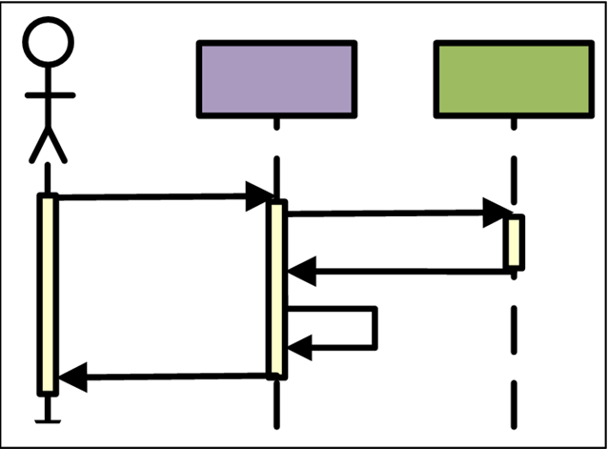


Approach
Data Dictionary
Non compliant scenarios
Evolution
scenarios
Software System Scenarios
Gap Analysis
Evolution
[Ayala-Rivera2024]
Notes:
As part of a GDPR compliance exercise, DP experts need to gather information about all the data assets held by the organization and the processing activities within the organization, which are typically documented in a data inventory (Piras et al., 2021).
For SoCo, we require the data inventory to be represented as a list of pieces of personal data (elements) included in information systems within the organization (hereafter referred to as a data dictionary). It is worth pointing out that conducting an organization-wide data audit is a fundamental step to comply with the GDPR, so it is normally part of any compliance exercise (Piras et al., 2019) (and good practice of data governance). Thus, we consider it reasonable to assume a data dictionary will already exist in the organization to be leveraged by SoCo.

Slide 14
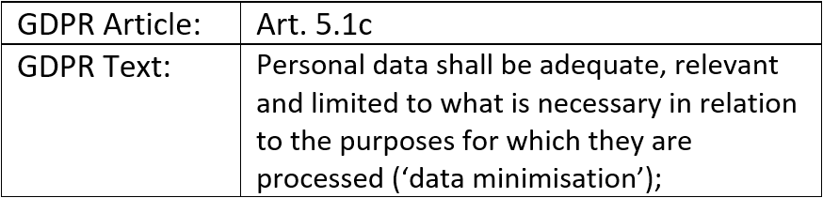
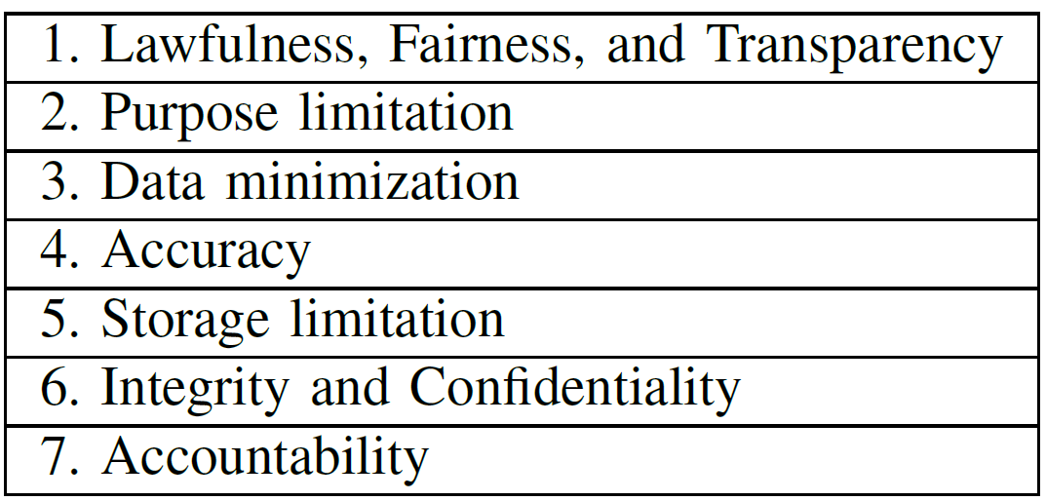
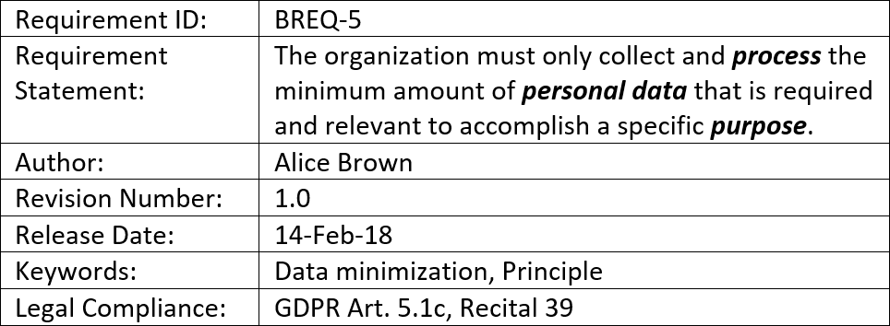
Data Dictionary
We created a Catalog of Business Requirements (BREQ)
Linked to GDPR Data Protection Principles
14
[Ayala-Rivera2018]

Slide 15
Data Dictionary
GDPR Data Protection Principles (BREQ)
The organization must only collect and <process> the minimum amount of <personal data> that is required and relevant to accomplish a <specific purpose>.
Data
Inventory
Data
Inventory
[Ayala-Rivera2018]

Slide 16
Data Dictionary
GDPR Data Protection Principles (BREQ)
The organization must only collect and <process> the minimum amount of <personal data> that is required and relevant to accomplish a <specific purpose>.
Data
Inventory
[Ayala-Rivera2018]

Slide 17
Data Dictionary
GDPR Data Protection Principles (BREQ)
The organization must only collect and <process> the minimum amount of <personal data> that is required and relevant to accomplish a <specific purpose>.
Data
Inventory
[Ayala-Rivera2018]

Slide 18
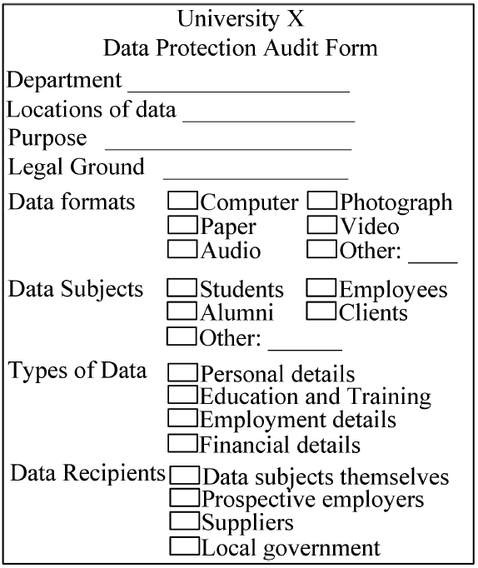
Data Dictionary
GDPR Data Protection Principles (BREQ)
The organization must only collect and <process> the minimum amount of <personal data> that is required and relevant to accomplish a <specific purpose>.
Data Audit
Data
Inventory
[Ayala-Rivera2018]

Slide 19
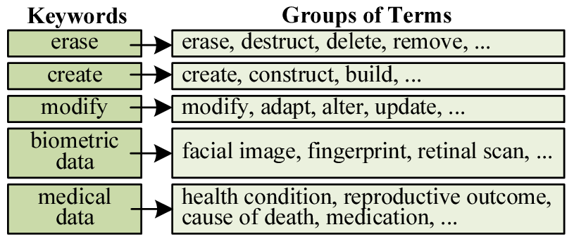
Data Dictionary
GDPR Data Protection Principles (BREQ)
The organization must only collect and <process> the minimum amount of <personal data> that is required and relevant to accomplish a <specific purpose>.
Processing activities
[Ayala-Rivera2018]
Notes:
An example is shown in Fig. 4. A data dictionary comprises: (1) Keywords, which are the words that serve as the standard terminology used in SoCo. They identify the data items or operations derived from the data inventory or the software system. (2) Related terms, which are words that have some connection among them and with their associated keyword. They can be synonyms of a keyword or words grouped intentionally. This <keyword-related term> format allows multiple terms to be grouped under the same key. This format allows identifying and fixing GDPR violations uniformly for similar diagrams while avoiding term inconsistencies. For instance, in the case of synonyms, they are used for supporting search and pattern matching in SoCo. For example, suppose an engineer defines the term erase as an operation of interest in a diagram. In that case, SoCo will also be able to detect automatically other similar operations such as cancel or delete (assuming they have been defined as related terms) and consider them during the filtering of the diagrams. This prevents diagrams applying similar data processing operations from being handled differently. The same applies to words grouped intentionally, such as special category data like “facial image” and “retinal scan”. Grouping them allows using the same priv&sec controls in all diagrams processing that data type. The data dictionary is represented as a .CSV file where each row represents a key (the first comma-separated value) and its related terms (from the second term onwards).

Slide 20
Data Dictionary
GDPR Data Protection Principles (BREQ)
The organization must only collect and <process> the minimum amount of <personal data> that is required and relevant to accomplish a <specific purpose>.
Processing activities
Data Items
[Ayala-Rivera2018]
Notes:
The same applies to words grouped intentionally, such as special category data like “facial image” and “retinal scan”. Grouping them allows using the same priv&sec controls in all diagrams processing that data type. The data dictionary is represented as a .CSV file where each row represents a key (the first comma-separated value) and its related terms (from the second term onwards).

Slide 21
Approach
Data Dictionary
Non compliant scenarios
Evolution
scenarios
Software System Scenarios
Gap Analysis
Evolution
[Ayala-Rivera2024]
Notes:
As part of a GDPR compliance exercise, DP experts need to gather information about all the data assets held by the organization and the processing activities within the organization, which are typically documented in a data inventory (Piras et al., 2021). For SoCo, we require the data inventory to be represented as a list of pieces of personal data (elements) included in information systems within the organization (hereafter referred to as a data dictionary). It is worth pointing out that conducting an organization-wide data audit is a fundamental step to comply with the GDPR, so it is normally part of any compliance exercise (Piras et al., 2019) (and good practice of data governance). Thus, we consider it reasonable to assume a data dictionary will already exist in the organization to be leveraged by SoCo.

Slide 22

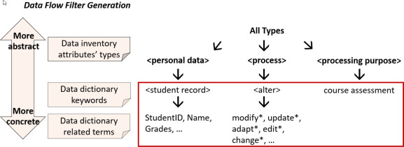
Gap Analysis
Data Flow Filter
Sequence Diagrams
Reverse Engineered using ObjectAid
Non compliant scenarios
22
22

Slide 23
Gap Analysis - Example
Data Flow Filter
<process> → <collect> → get*, retrieve*, ..
Operations: get*, retrieve*, ..
<personal data> → <studentInfo> → name, DoB, email, address, …
<purpose> → marking

Slide 24
Gap Analysis - Example
Data Flow Filter
Operations: get*, retrieve*, ..
Data Type: Student.email, Student.address,Student.phone
<personal data> → <studentInfo> → name, DoB, email, address, …
<purpose> → marking

Slide 25
Gap Analysis - Example
Data Flow Filter
Operations: get*, retrieve*, ..
Data Type: Student.email, Student.address,Student.phone
…
<purpose> → marking
Purpose: Not inside grading flow

Slide 26
Gap Analysis - Example

Slide 27
Approach
Data Dictionary
Non compliant scenarios
Evolution
scenarios
Software System Scenarios
Gap Analysis
Evolution
[Ayala-Rivera2024]

Slide 28
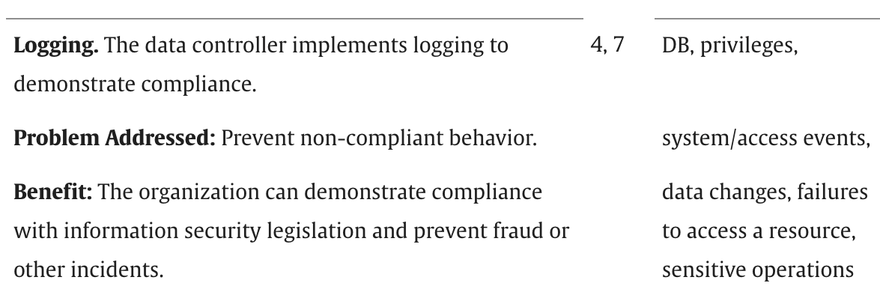
Privacy Controls Catalog
Current version: 47 controls from the ISO 29100 Privacy Framework
https://github.com/oportillo78/SoCo
Notes:
The catalog currently has 47 controls. Each control contains a description of the control, the problem it can address, its type (i.e., security, privacy, or both), the gains obtained by implementing it, and the GDPR DPPs it best contributes to satisfying.
Five experts in requirements, security and privacy engineering, and human–computer interaction validated the mapping between the GDPR DPPs and the controls (Ayala-Rivera and Pasquale, 2018).

Slide 29
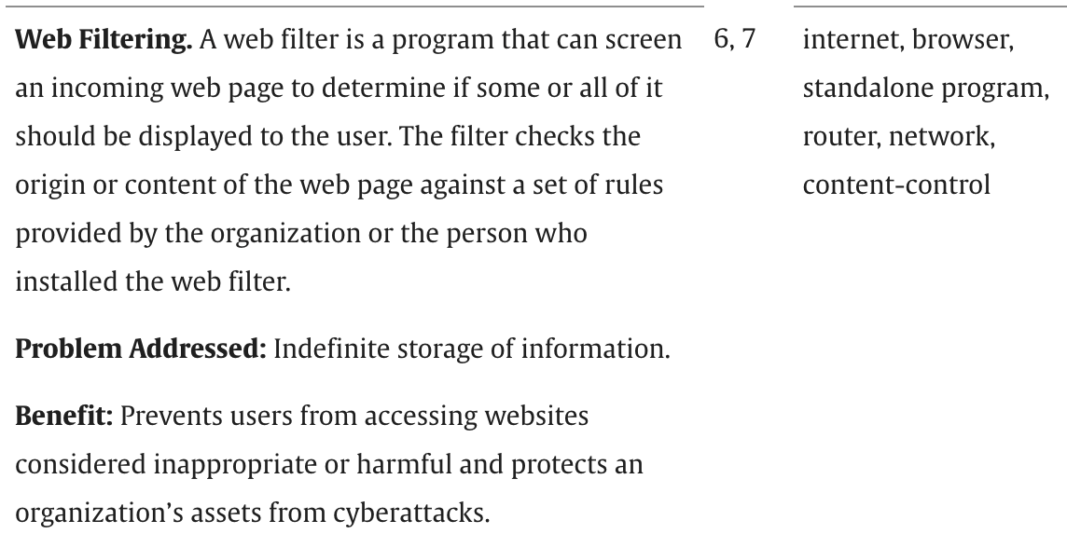
Privacy Controls Catalog
Current version: 47 controls from the ISO 29100 Privacy Framework
Notes:
Current version: 40 controls from the ISO 29100 Privacy Framework

Slide 30
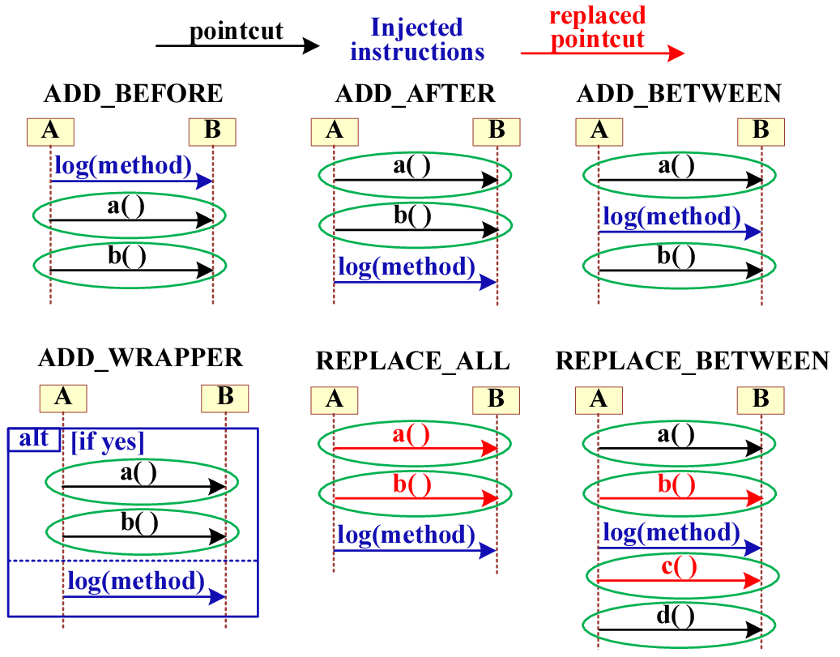
Template for Priv&Sec Controls
Notes:
The pointcut identifies where a priv&sec control should be injected in a non-compliant diagram. To achieve this aim, the engineer should specify the messages that need to occur in a sequence diagram to trigger the injection of priv&sec controls.
A pointcut is specified by indicating the characteristics of the messages such as the action occurring (ProcessingOperation), the type of personal data exchanged (DataType), the total number of messages that need to be intercepted to recognize a scenario of interest (NumOfMessages), and the actors involved (Actors
The advice behavior of the Logging control example is presented in Listing 1. It forces a service in the system to ask the Logger to record a transaction. To do so, the Logger de-identifies the logging information and subsequently writes the transaction. As shown in Listing 1, it is possible to declare tokens for certain model entities (represented by words starting with $), so they can be replaced by specific component instances of the target system to facilitate the customization of the controls. For example, “$service” can refer to the SIS, whereas “$transaction” can refer to the object holding the details that will be used to modify a record in the database.
The advice specifies the behavior that will be added to the diagram (i.e., the instructions that compose the implementation of a priv&sec control). An advice is characterized by a type (AdviceType) indicating (a) if the advice adds, removes, or modifies functionalities and (b) where the priv&sec actions will be inserted w.r.t. to the pointcut. The supported types of advice are shown in Fig. 7. ADD_BEFORE, ADD_AFTER, and ADD_BETWEEN add functionality to the system before, after, or between the intercepted messages. WRAP_AROUND adds functionality around the messages (e.g., adding conditional statements to process personal data only if consent was obtained). REPLACE_BETWEEN replaces functionality comprised between two message sequences. REPLACE_ALL replaces a message sequence with another (e.g., replacing a user-based access control with a role-based one). The advice behavior is specified using PlantUML instructions, which use a simple textual notation for UML diagrams (PlantUML, 2023).
The advice behavior of the Logging control example is presented in Listing 1. It forces a service in the system to ask the Logger to record a transaction. To do so, the Logger de-identifies the logging information and subsequently writes the transaction. As shown in Listing 1, it is possible to declare tokens for certain model entities (represented by words starting with $), so they can be replaced by specific component instances of the target system to facilitate the customization of the controls. For example, “$service” can refer to the SIS, whereas “$transaction” can refer to the object holding the details that will be used to modify a record in the database.

Slide 31
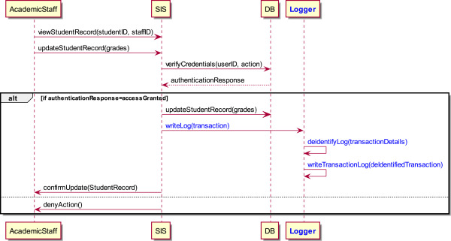
Evolution – Example

Slide 32
Intro to GDPR Compliance
Our Approach to Support Software Compliance
Gap Analysis
Evolution
Evaluation
Discussion & Future Work

Slide 33


Evaluation
RQ1) What Manual Activities shall a software engineer perform to apply our approach in practice?
RQ2) Can our approach be applied to a large-scale software project?
- 445K lines of code
- 228 entity types
- 343 processing
15+ YoE
Familiarity with GDPR DPP, Fenix Edu
2h Workshop to describe our approach
Notes:
Multiple studies have identified Education as a critical sector in the cybersecurity landscape
An additional benefit of selecting an academic system is that we can leverage our personal knowledge and expertise in the area (i.e., as subject–matter experts) to understand the implications of security and privacy issues in Education;
FenixEdu is a real-world web application that is not only used by several Portuguese universities

Slide 34
Evaluation – Manual Activities
Data Dictionary
Generation of Data-Flow Filters
Configuration of Priv&Sec Controls
GDPR Relevant Sequence Diagrams
Notes:
Since we did not perform an entire GDPR compliance exercise, we created a data inventory (i.e., artifact resultant of a data mapping activity) using two publicly-available lists of personal data collected by universities (UCD, 2024, Maynooth University, 2018).
This resulted in the documentation of 48 personal data items (e.g., email, salary)
45 processing operations (e.g., store, alter). Based on such data inventory, we created the data dictionary. The data inventory’s personal data elements became the keywords, while their respective synonyms became the related terms.
A diagram qualifies as GDPR-relevant if at least one message in the diagram contains one of the following combinations of keywords or their related terms: (1) a processing operation ＋ a personal data item (e.g., store ＋ curriculum vitae), or (2) a processing purpose ＋ a personal data item (e.g., advertising ＋ employment status), or (3) a processing operation ＋ a processing purpose (e.g., modify ＋ appeal examination). We used “contains” (ignoring case) as the main function to compare the text inside the diagrams. This resulted in 285 diagrams identified as GDPR-relevant. The relevant diagrams involved mostly student-centric data flows such as students’ grading. The non-relevant diagrams involved administrative processing activities (e.g., the configuration of holidays), while other diagrams did not qualify as relevant because the method’s name was in Portuguese instead of English (e.g., setDisciplinaExecucao). Finally, for our study, we assumed that all the relevant diagrams were non-compliant with the GDPR DPPs. The rationale behind this assumption is that FenixEdu was not designed and developed as a GDPR-compliant application.
Whenever the participant identified a new pattern for a potential pointcut in a diagram (i.e., the possible location where a priv&sec control could be applicable), he created a data flow filter to find similar diagrams. For example, the participant created filter identifying CRUD operations to quickly retrieve the diagrams where an Audit control should be applied. Overall, he created 31 filters and assigned them meaningful names to recognize them later.

Slide 35
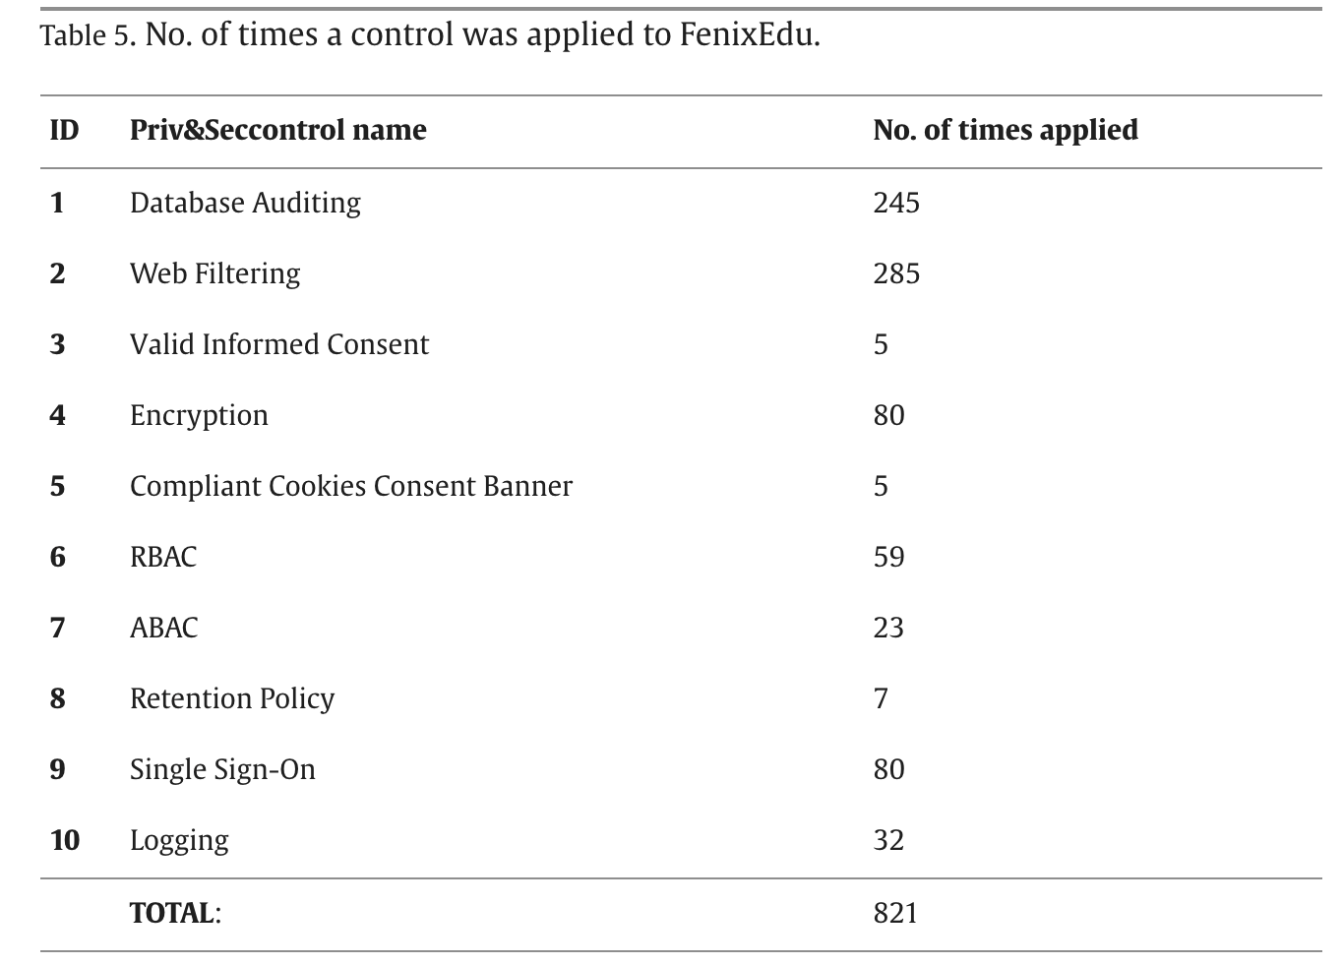
Evaluation – Manual Activities
Injection logic worked correctly for 81.5% of the cases (i.e., 661) and incorrectly for 19.5% of the cases (i.e., 160).
Errors Explanations
two controls were applied to the same diagram
a control involved replacing some of the messages modified by another control applied previously
Notes:
The results showed that most controls were applied correctly, with no pointcut instances omitted. The injection logic worked correctly for 81.5% of the cases (i.e., 661) and incorrectly for 19.5% of the cases (i.e., 160). The error cases exhibited an issue where the text of a message was modified incorrectly by our tool while injecting the priv&sec controls. This happened when the following conditions co-occurred: (1) The user enabled the option to highlight in color the changes made in the evolved diagrams, (2) two controls were applied to the same diagram, and their advices had the same messages, and (3) the advice of the second control involved replacing some of the messages previously modified by the first control. Regarding the implications of this issue, the controls were injected in the right location, and the correct set of messages and actors were modified, removed, and/or added . However, the text of the messages that overlapped (i.e., those previously modified by the first control) was corrupted, as the color tag added to represent its previous modification was not removed. For instance, the text “color blue” should not be duplicated in the following message “AccountingEventsCreator → AccessControl: <color blue>[color blue]getPerson() : Person”. This issue impacted all the injections involving the SSO and Encryption controls (as both controls were applied to the Person entity).The results showed that most controls were applied correctly, with no pointcut instances omitted. The injection logic worked correctly for 81.5% of the cases (i.e., 661) and incorrectly for 19.5% of the cases (i.e., 160). The error cases exhibited an issue where the text of a message was modified incorrectly by our tool while injecting the priv&sec controls. This happened when the following conditions co-occurred: (1) The user enabled the option to highlight in color the changes made in the evolved diagrams, (2) two controls were applied to the same diagram, and their advices had the same messages, and (3) the advice of the second control involved replacing some of the messages previously modified by the first control. Regarding the implications of this issue, the controls were injected in the right location, and the correct set of messages and actors were modified, removed, and/or added . However, the text of the messages that overlapped (i.e., those previously modified by the first control) was corrupted, as the color tag added to represent its previous modification was not removed. For instance, the text “color blue” should not be duplicated in the following message “AccountingEventsCreator → AccessControl: <color blue>[color blue]getPerson() : Person”. This issue impacted all the injections involving the SSO and Encryption controls (as both controls were applied to the Person entity).

Slide 36
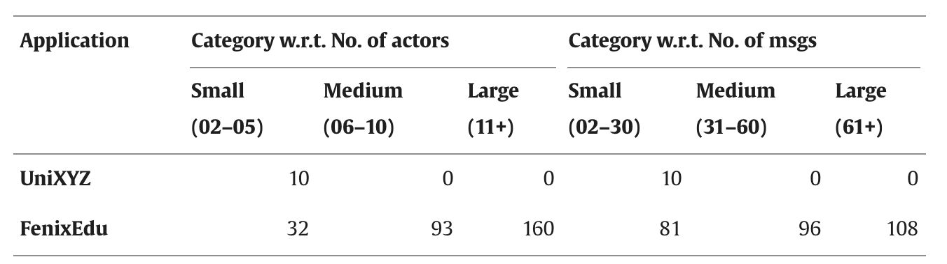
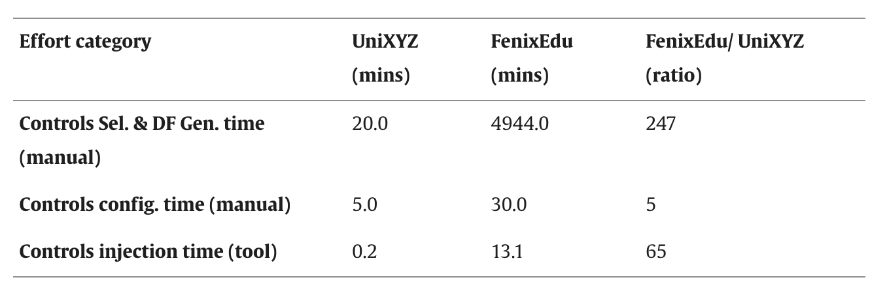
Evaluation – Effort Comparison
Non-compliant diagrams
UniXYZ: 10
FenixEdu: 285
Notes:
By far, the analysis of the diagrams to determine which controls need to be selected involved the highest ratio.
This effort depends on the number of diagrams (whose FenixEdu/UniXYZ ratio is 28) and the number of messages.
On the contrary, configuring the templates of the priv&sec controls in FenixEdu required only five times the effort we spent with UniXYZ.
This resulted from using our pre-filled templates, which only required the participant to perform some adjustments to tailor them to FenixEdu. The time to inject priv&sec controls was also higher in FenixEdu due to the number of non-compliant diagrams (285, while UniXYZ had 10) and their size (the average number of messages per diagram was 59, while in UniXYZ was 8). However, the throughput of our tool (i.e., the number of messages processed per second) was the same in both cases (ten messages). This suggests that injection scales linearly w.r.t. the total number of messages, irrespectively of the actual number of diagrams.

Slide 37
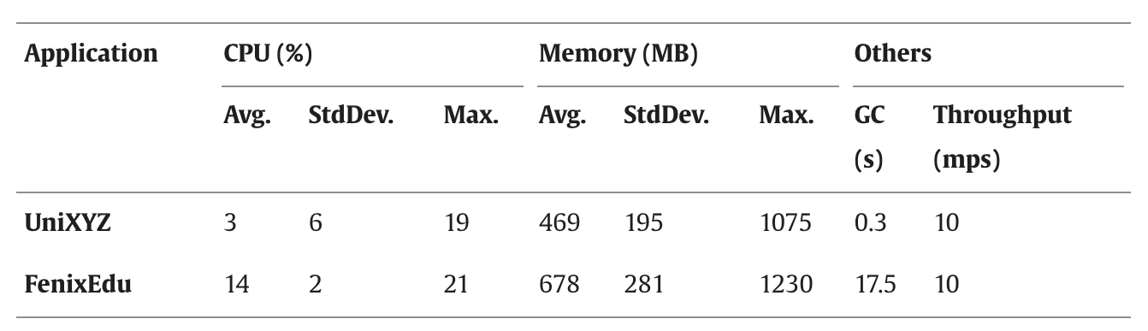
Evaluation – Performance
Non-compliant diagrams
UniXYZ: 10
FenixEdu: 285
Notes:
The time to inject priv&sec controls was also higher in FenixEdu due to the number of non-compliant diagrams (285, while UniXYZ had 10) and their size (the average number of messages per diagram was 59, while in UniXYZ was 8).
However, the throughput of our tool (i.e., the number of messages processed per second) was the same in both cases (ten messages). This suggests that injection scales linearly w.r.t. the total number of messages, irrespectively of the actual number of diagrams.

Slide 38
Intro to GDPR Compliance
Our Approach to Support Software Compliance
Objective & Novelty
Gap Analysis
Evolution
Evaluation
Discussion & Future Work

Slide 39
Discussion and Future Work
Identification of GDPR Violation Scenarios
Prv&Sec Controls Evaluation Sample
Case Studies and Participants’ Profile
Text Similarity Techniques
Translation of Sequence Diagrams to Code
Notes:
Organizations can leverage diverse types of strategies to identify GDPR violations such as studying guidelines (ICO UK, 2018b) or case studies (DPC Ireland, 2023) from supervisory authorities, conducting Data Protection Impact Assessments (DPIAs) (DPC Ireland, 2018), using threat modeling methodologies for security (Thevarmannil, 2023) or privacy (KU Leuven, 2023), or simply consulting the expert judgment from a legal team.
SoCo has been purposely designed to be agnostic of such strategies, SoCo simply requires the non-compliant scenarios to be fed modeled as sequence diagrams. However, we acknowledge that integrating SoCo to such types of techniques can bring interesting benefits for practitioners (e.g., time savings, elimination of potential redundant steps). Therefore, finding effective ways to properly support artifacts derived from those techniques will be considered as a potential extension of our research work in the future.
Priv&Sec Controls Evaluation Sample: Although only 10 priv&sec controls were part of our evaluation sample, our results demonstrate that they were sufficient to address the scenarios identified as non-compliant with GDPR DPPs in FenixEdu. This set of controls was selected because they are considered basic and foundational cybersecurity measures in organizations
Case Studies and Participants’ Profile: So far, SoCo has been evaluated by a seasoned software architect to demonstrate the feasibility of the approach and tools for supporting the software compliance with GDPR. Nevertheless, we plan to strengthen our evaluation by conducting more case studies, preferable involving multiple IT professionals and applications in other industry sectors, in order to further test our approach’s performance and generalizability.
SoCo currently uses syntactic similarity to search for data items and operations in the sequence diagrams. We decided to go in this direction because engineers usually follow meaningful programming naming conventions, including using standard nouns and verbs for the entities and behaviors represented in a software system (Butler et al., 2015). Moreover, syntactic and lexical similarity techniques are commonly used in code scanning tools as they focus on the structural and grammatical aspects of code rather than its semantic or functional behavior (Gali et al., 2019, Kılıç and Sandıkkaya, 2023). Since the sequence diagrams fed to SoCo will ultimately be translated into code instructions by engineers, we followed this same principle. Additionally, we opted for not using semantic similarity techniques because words and phrases often have multiple meanings in natural language depending on the context, and automatic semantic matching might struggle to disambiguate terms correctly (hence, potentially resulting in false matches). Therefore, we opted to leverage semantic similarity to expand the data dictionary, and then review/clean it by removing any invalid terms/synonyms (as explained in Section 4). This strategy helps to achieve the benefits of semantic matching, while also preventing its potential issues (as discussed in our evaluation). Finally, although SoCo currently uses “contains” (ignoring case) as its primary function to assess similarity, it is planned to include other functions in the future (e.g., a semantic one).
Translation of Sequence Diagrams to Code: Once engineers complete the steps involved in SoCo, the evolved sequence diagrams modeling the fixed GDPR DPP violations are ready to guide engineers in the development phase of the SDLC. That is, engineers would implement the security measures and associated changes suggested by SoCo to reflect the software evolution. Since the aim of SoCo is to support engineers in the design phase of the SDLC, SoCo currently does not offer a functionality to automatically generate source code based on the evolved sequence diagrams. However, automatic code generation from UML sequence diagrams is a well-studied field not only in the literature (Parada et al., 2011, Kundu et al., 2013, Paolone et al., 2020) but also applied in commercial tools (Altova GmbH, 2023). Depending on the programming language used, there are typically tools that can assist engineers with this task. For instance, integrated development environments (e.g., Eclipse, IntelliJ IDEA) usually offer UML modeling and code generation plugins. We plan to leverage some of these approaches to integrate them into SoCo to further automate the process of implementing priv&sec controls for GDPR compliance. Although the generated code may lack all the architectural considerations and optimizations that engineers might introduce (depending on the complexity of the diagrams), this approach is common in the industry, as it provides a fair starting point for engineers to work with.

Slide 40
Benefits to Practitioners
Practical Guidance to GDPR Compliance
Benchmarking Opportunities
Support for Automated Compliance Activities
https://github.com/oportillo78/SoCo
Notes:
ractical guidance towards GDPR compliance: Previous research work has identified that developers are not able to implement GDPR effectively into software development practice due to the lack of familiarity with GDPR DPPs and the lack of knowledge on what techniques to use (or how to implement them) (Alhazmi and Arachchilage, 2021). Our research provides value to practitioners as it helps to solve these issues by providing them with direct guidance on how to operationalize the GDPR DPPs in software systems. Through the use of our catalog that maps priv&sec controls with GDPR DPPs, practitioners can know what controls to use to fix a GDPR-violating scenario. Moreover, our proposed techniques support practitioners to know where in the data processing activity such priv&sec controls can be integrated and how they can be technically implemented. Practitioners can also gain a deeper understanding of where GDPR violations can arise in data processing activities present in software functionality and how they can be addressed because SoCo allows to filter sequence diagrams in the scope of GDPR. All these contributions help to advance the body of knowledge intersecting the fields of software security and software engineering.
•Benchmarking Opportunities: To promote research reproducibility, our research work includes a ready-to-use prototype implementation of SoCo which is publicly available as a GitHub project (Ayala-Rivera et al., 2023). This also includes easy-to-follow instructions to build the prototype, as well as an automated way to replicate the experiments performed in this paper (with only 5 mouse clicks). Other artifacts (such as the catalog of controls, scenarios used, etc.) are also available for researchers (Ayala-Rivera et al., 2024). We also plan to adopt FAIR principles (Lamprecht et al., 2020) for our tool and other artifacts developed in our research work. Thus, SoCo can act as a benchmark or rival technique for evaluating other research efforts tackling similar research problems. This can also facilitate comparative studies and foster healthy competition within the research community.
•Support Automate Compliance Activities: Our proposed approach can also contribute to the efforts of organizations to automate compliance activities. This can lead to more efficient and effective software development processes, ultimately helping to make software more secure and compliant, while also less costly and more maintainable. In particular, providing practical tools to support engineers in implementing priv&sec controls can help to increase the productivity of practitioners and at the same time reduce the level of errors that may lead to security incidents and therefore data breaches.

Slide 41

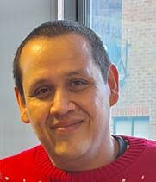
Dr Vanessa Ayala-Rivera
Dr. Omar Portillo-Dominguez

Slide 42
References
I. Hadar, T. Hasson, O. Ayalon, E. Toch, M. Birnhack, S. Sherman, A. Balissa. “Privacy by designers: software developers’ privacy mindset” Empir. Softw. Eng., 23 (1) (2018), pp. 259-289
E. Dias Canedo, C. A. Toffano Seidel, M. E. Toffano Seidel, P. H. Teixeira Costa, F. Lima “Perceptions of ICT practitioners regarding software privacy” Entropy, 22 (4) (2020), p. 429
Y.-S. Martin, A. Kung, “ Methods and tools for GDPR compliance through privacy and data protection engineering”, IEEE EuroS&PW (2018), pp. 108-11
V. Ayala-Rivera, A. Omar Portillo-Dominguez, Liliana Pasquale, “GDPR compliance via software evolution: Weaving security controls in software design”, Journal of Systems and Software, Vol. 216, 2024.
V. Ayala-Rivera, and L. Pasquale. "The Grace Period Has Ended: An Approach to Operationalize GDPR Requirements." In 2018 IEEE 26th International Requirements Engineering Conference (RE), pp. 136-146. IEEE, 2018.

Slide 43


Thank You

