Slide 1
A Software Engineering Research Team’s Dive into FinTech
FutureFintech Federated Conference
Dr. Jordan Samhi - March, 13th 2025

Slide 2
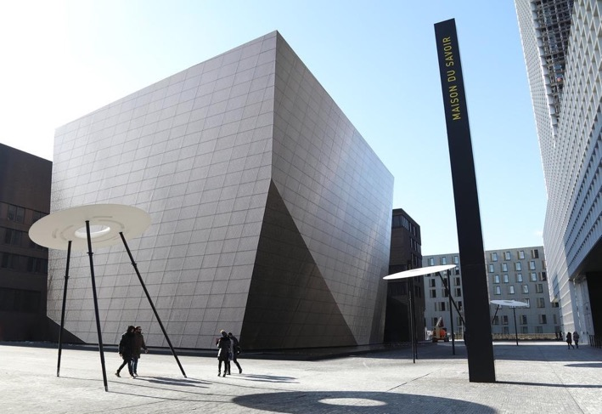


Who we are
The University of Luxembourg
The University of Luxembourg is a research university with a distinctly international, multilingual and interdisciplinary character.
The University’s ambition is to provide the highest quality research and teaching in its chosen fields and to generate a positive scientific, educational, social, cultural and societal impact in Luxembourg and the Greater Region.
Ranked
~7000
270
56%
12th Young University
students
faculty members
international students
worldwide and #1 worldwide for its “international outlook” in the Times Higher Education (THE) World University Rankings 2020
129
~1000
PhDs
nationalities
2

Slide 3







Who we are
The University of Luxembourg
Research Focus Areas
Computer Science & ICT Security
Finance and Financial Innovation
Education
Materials Science
Contemporary and Digital History
Interdisciplinary theme: Health and Systems Biomedicine
Interdisciplinary theme: Data Modelling and Simulation
3 Faculties
4 Interdisciplinary Centres

Slide 4
Who we are
The University of Luxembourg
Research Focus Areas
Computer Science & ICT Security
Finance and Financial Innovation
Education
Materials Science
Contemporary and Digital History
Interdisciplinary theme: Health and Systems Biomedicine
Interdisciplinary theme: Data Modelling and Simulation
3 Faculties
4 Interdisciplinary Centres

Slide 5






Who we are
Collaborative, demand-driven research model based on strategic partnerships
Our vision
A leading international
research and innovation centre in secure, reliable and trustworthy ICT systems and services. We play an instrumental role in Luxembourg by boosting R&D investments leading to economic growth and highly qualified talent.
High-risk
long-term research
Interdisciplinary
research approach in key economic sectors
Highly selective
global recruitment

Slide 6

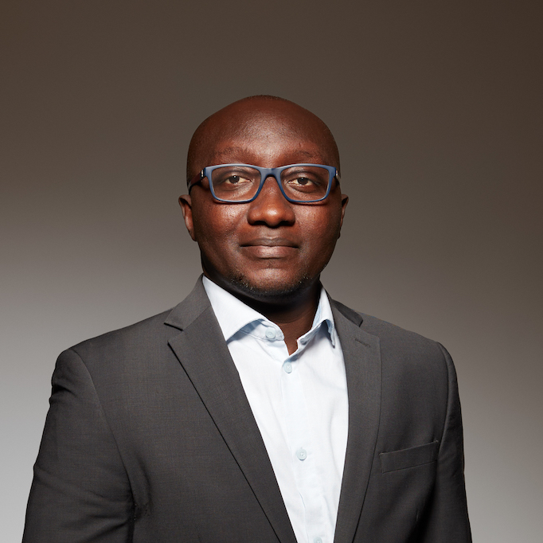
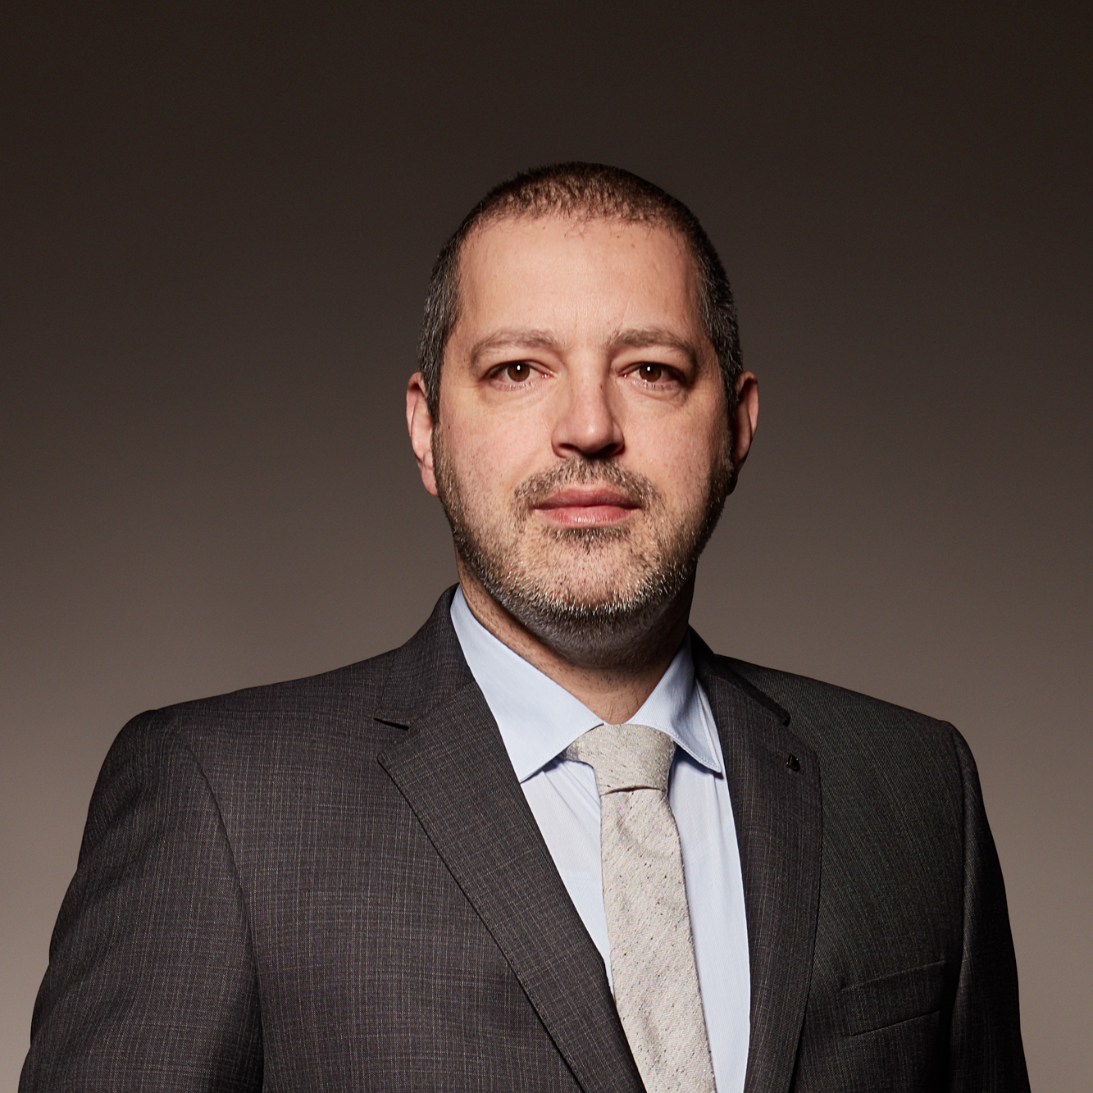
Trustworthy Software Engineering
TruX Research Group
Prof. Tegawendé F.
BISSYANDE
Prof. Jacques
KLEIN

Slide 7
TruX
TruX People
PhD Students
Fatou Ndiaye MBODJI (Apr. 2021)
Xunzhu TANG (Oct. 2021)
Damien FRANCOIS (Nov. 2021)
Weiguo PIAN (Jan 2022)
Alioune DIALLO (Feb. 2022)
Christian OUEDRAOGO (Apr. 2022)
Aicha WAR (May 2022)
Yewei SONG (Jun. 2022)
Despoina GIARIMPAMPA (Sep. 2022)
Marco ALECCI (Oct. 2022)
Fred PHILIPPY (Mar. 2023)
Jules WAX (Mar. 2023)
Moustapha DIOUF (Apr. 2023)
Micheline MOUMOULA (Oct. 2023)
Pedro RUIZ JIMÉNEZ (Nov. 2023)
Omar EL BACHYR (Feb. 2024)
Prateek RAJPUT (Mar. 2024)
Albérick DJIRE (Mar. 2024)
Maimouna Tamah DIAO (Apr. 2024)
Maimouna OUATTARA (May 2024)
Aziz BONKOUNGOU (Jul. 2024)
Serge Lionel NIKIEMA (Jul. 2024)
Loic TALEB (Dec, 2024)
Pawel BORSUKIEWICZ (Dec. 2024)
Professors
Research Associates
Tegawendé F. BISSYANDE (head)
Jacques KLEIN (co-head)
Yinghua LI
Tiezhu SUN
Aleksandr Pilgun (coming soon)
Navid Khaledian (coming soon)
Ty Malloy (coming soon)
Olatunji Emmanuel (coming soon)
Research Scientist
Jordan SAMHI
Assistant
R&D Specialist
Fiona LEVASSEUR
Laura Bernardy
INDIA
1
GREECE
1
SPAIN
1
ITALY
1
MOROCCO
1
LUXEMBOURG
2
FRANCE
5
SENEGAL
5
CHINA
5
BURKINA FAS0
8

Slide 8
We specialize in Software Research

Slide 9
TruX
Trustworthy Software Engineering (TruX)
Prof. Tegawendé F. Bissyandé
Prof. Jacques Klein

Slide 10

TruX
Trustworthy Software Engineering (TruX)
Prof. Tegawendé F. Bissyandé
Prof. Jacques Klein
Mobile App Analysis
Program (static) analysis
Vulnerability detection
Malware Detection
GDPR Compliance
Software Security

Slide 11

TruX
Trustworthy Software Engineering (TruX)
Prof. Tegawendé F. Bissyandé
Prof. Jacques Klein
Mobile App Analysis
Program (static) analysis
Vulnerability detection
Malware Detection
GDPR Compliance
Patch Recommendation
Automated Program Repair
Bug Detection
Vulnerability patching
Software Security
Software
Debugging

Slide 12

TruX
Trustworthy Software Engineering (TruX)
Prof. Tegawendé F. Bissyandé
Prof. Jacques Klein
Mobile App Analysis
Program (static) analysis
Vulnerability detection
Malware Detection
GDPR Compliance
Patch Recommendation
Automated Program Repair
Bug Detection
Vulnerability patching
Software Security
Software
Debugging

Slide 13

TruX
Mining Software
Trustworthy Software Engineering (TruX)
Prof. Tegawendé F. Bissyandé
Prof. Jacques Klein
Information Retrieval
Natural Language Processing
Time Series Pattern Recognition
Machine learning, Explainable ML
Mobile App Analysis
Program (static) analysis
Vulnerability detection
Malware Detection
GDPR Compliance
Patch Recommendation
Automated Program Repair
Bug Detection
Vulnerability patching
Software Security
Software
Debugging

Slide 14

TruX
Mining Software
Trustworthy Software Engineering (TruX)
Prof. Tegawendé F. Bissyandé
Prof. Jacques Klein
Information Retrieval
Natural Language Processing
Time Series Pattern Recognition
Machine learning, Explainable ML
Mobile App Analysis
Program (static) analysis
Vulnerability detection
Malware Detection
GDPR Compliance
Patch Recommendation
Automated Program Repair
Bug Detection
Vulnerability patching
Software Security
Software
Debugging
Outcomes
About 100 published papers (last 5 years), most of them in Rank A or Rank A*
Several Benchmark, Repositories (e.g., AndroZoo), and Tools made publicly available to the community

Slide 15
The History of a Long-Standing Collaboration

Slide 16

A Software Engineering Research Team’s Dive into FinTech
The Partner

Slide 17
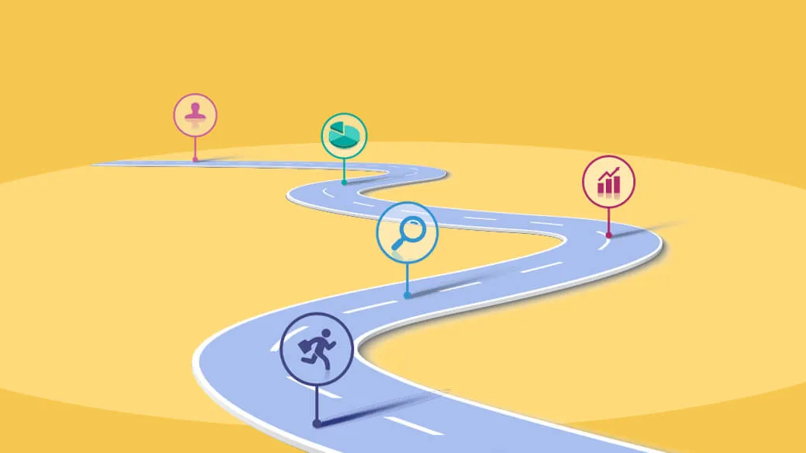

The journey started in 2018
Way before LLMs!

Slide 18





A Software Engineering Research Team’s Dive into FinTech
How did it start?
When we started => end of 2018 (before LLMs, etc.)
Weicker Foundation Funding
Strong needs of BGL to apply new techniques to automate processes and tasks
=> Which ones fit the best? It was not known at the beginning
==> One of this task was the develop a ChatBot.
Challenge 1: How to create a big dataset of questions/answers? ( at this time, this was the main solution to create a chatbot: create the knowledge base)
Challenge 2: How to deal with questions written in Luxembourgish?
Solution to Challenge 1 => Harvest the emails of the banks:
Solution to Challenge 2 => Develop the first transformer based Model for luxembourguish: LuxemBERT
Innovation of LuxemBERT: - Luxembourgish can be considered as a low resource language: no enough data in Lux. (only 6 milions sentences)
The idea was to consider German sentences and translate main words to Lux. => new sentence in pseudo Lux.
A lot of press coverage for LuxemBERT

Slide 19

What
Task?

Slide 20

A Software Engineering Research Team’s Dive into FinTech
A Chatbot!
Wéi geet et dir?
Moien!
Ech hunn dat net verstanen!
Gudd Nuecht!
Äddi!

Slide 21
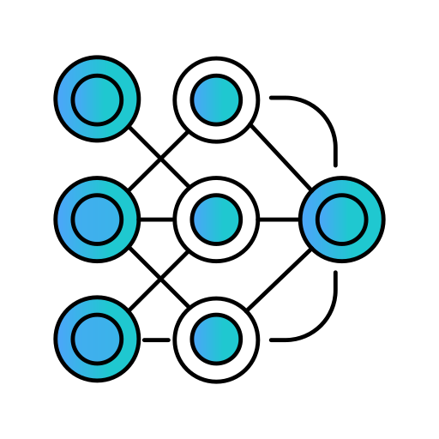

A Software Engineering Research Team’s Dive into FinTech
Some issues we faced
➔ LLMs were not mainstream yet!
Challenge 1: We needed a huge dataset of questions with their answers
Challenge 2: It is hard to find big datasets of Luxembourguish

Slide 22

Solution to Challenge 1
Emails!

Slide 23

Solution to Challenge 2
➔ Develop the first transformed-based chatbot for Luxembourguish!
❓ Wéi kann ech e Konto opmaachen?
💬 Dir kënnt e Konto online oder an enger Filial opmaachen.
❓ Wéi kann ech mäi Kontosaldo iwwerpréiwen?
💬 Dir kënnt Äre Solde an der Mobil-App oder um Online-Banking kucken.
❓ Wéi eng Zënssätz bidde Dir un?
💬 D’Zënssätz variéieren no Kontotyp. Kuckt w.e.g. eis Websäit.
❓ Wéi kann ech e Prêt ufroen?
💬 Dir kënnt e Prêt online ufroen oder an eng Filial kommen.

Slide 24
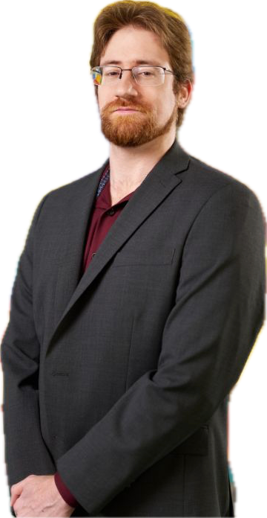
A Software Engineering Research Team’s Dive into FinTech
This led to
LuxemBERT
Dr. Cedric Lothritz

Slide 25
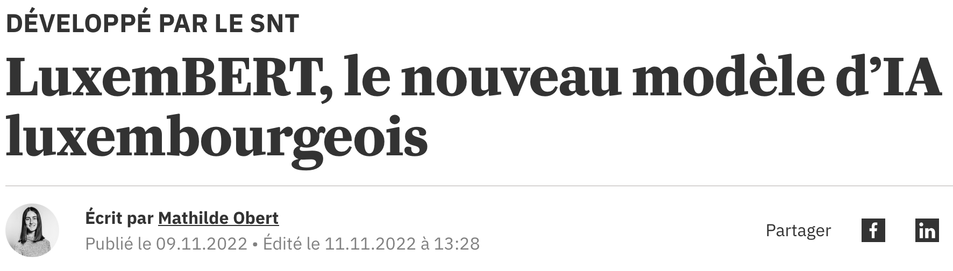
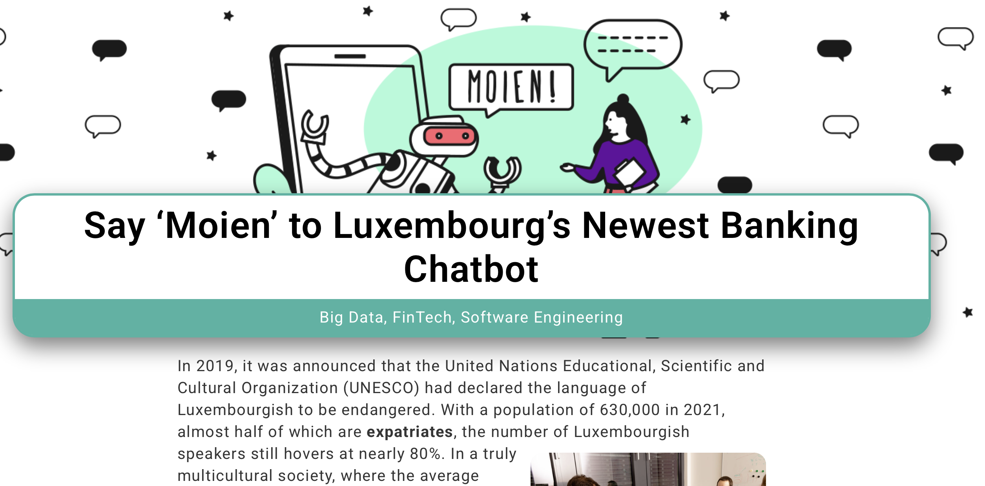

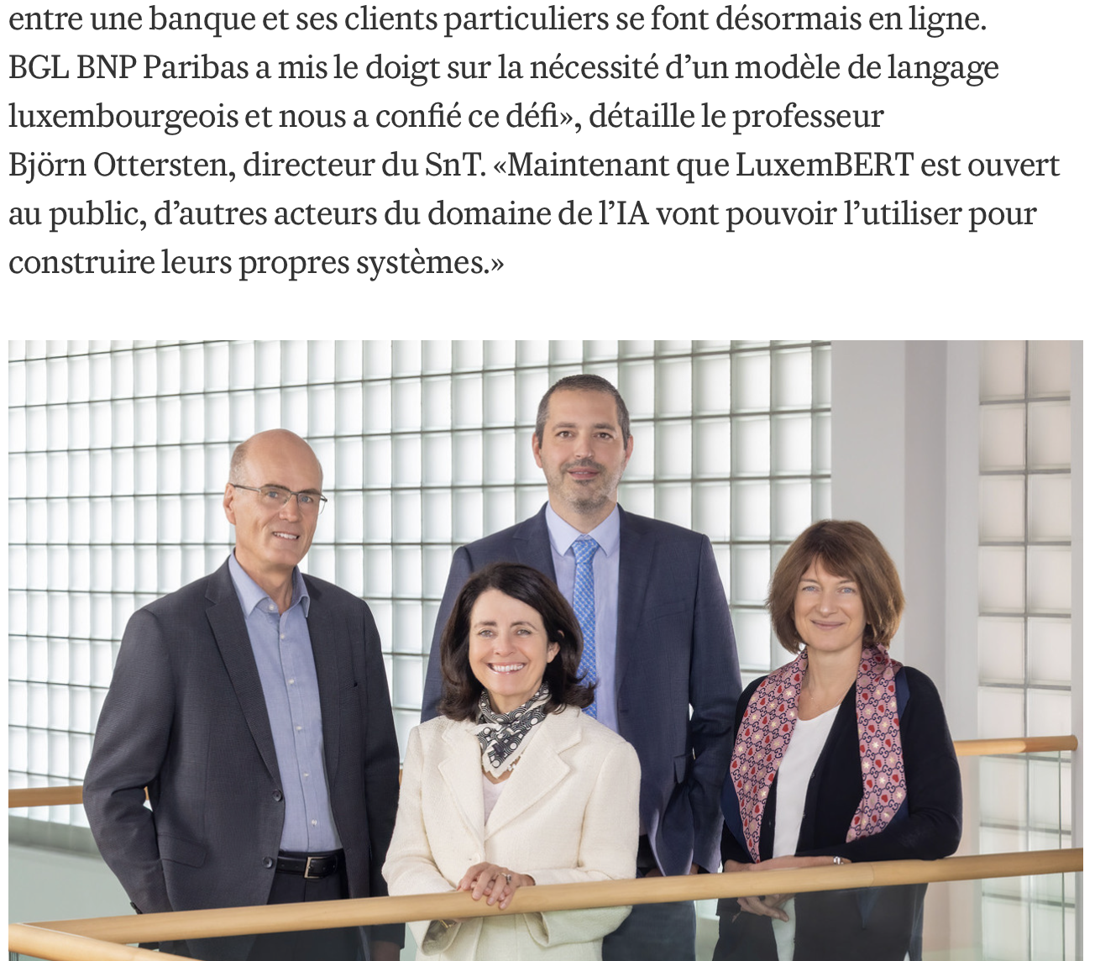
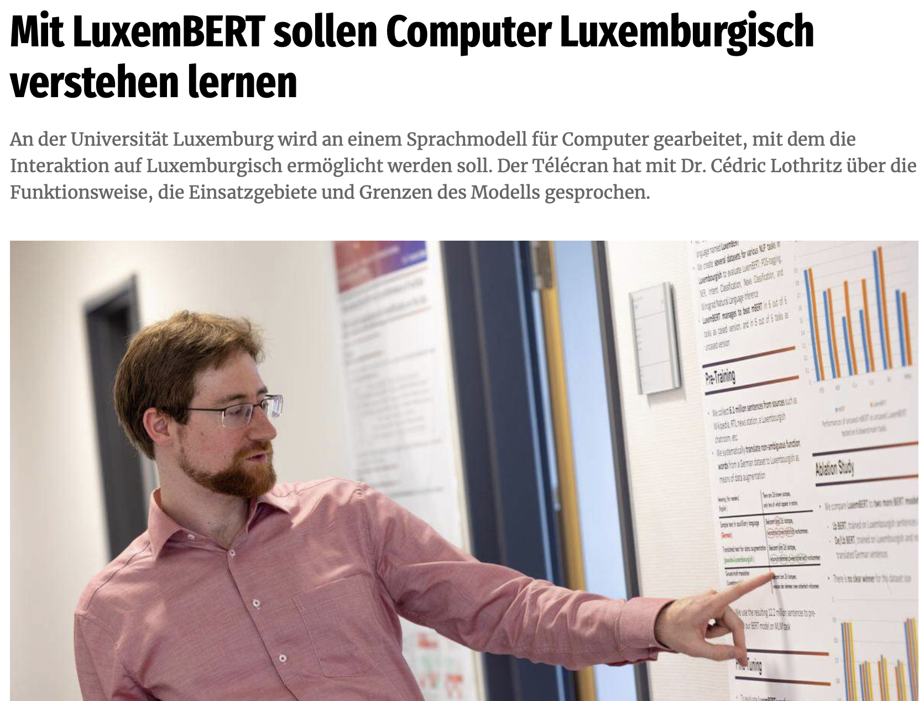
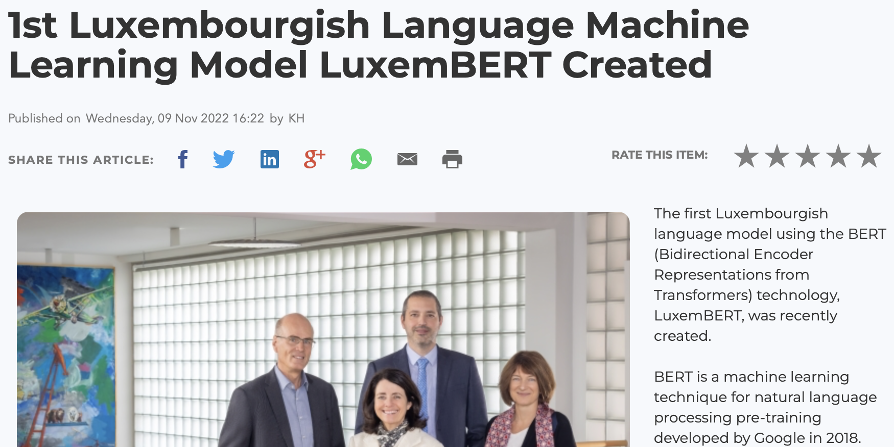
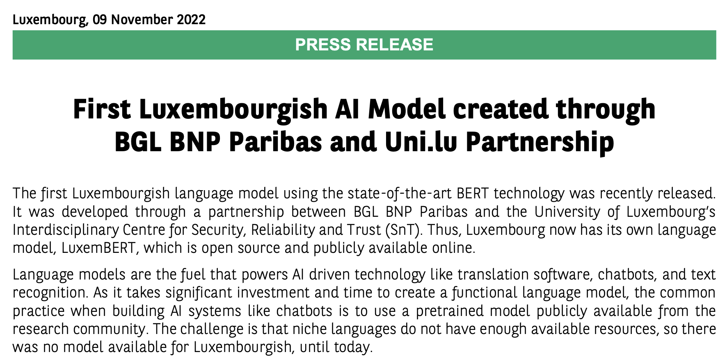
A Software Engineering Research Team’s Dive into FinTech
LuxemBERT received a lot of press coverage!

Slide 26
Is it actionable?

Slide 27
A Software Engineering Research Team’s Dive into FinTech
Not actionable
The technique is too static
Answers can actually be in other places
Answers were not human-like in most cases

Slide 28









A Software Engineering Research Team’s Dive into FinTech
Large Language Models

Slide 29
Today
Leveraging LLMs, RAG for Q/A

Slide 30


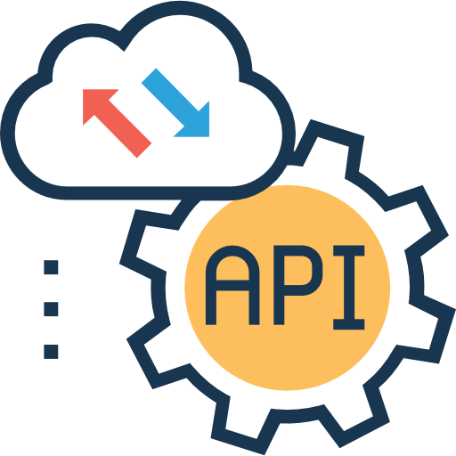
A Software Engineering Research Team’s Dive into FinTech
Background RAG
What is a RAG: background 15 sec
Question for which the answer is not in the knowledge of the LLMs

Slide 31




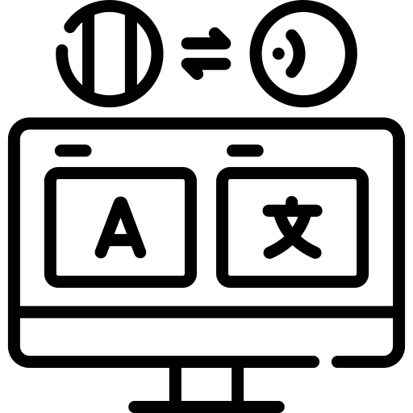

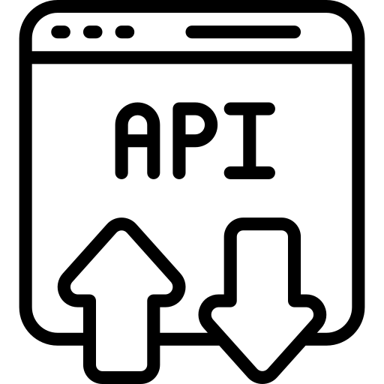

LLM-RAG System
Clients
Agents
Chat-bot
Answer
Translator
Databases
API Callings
Documents
To make a functional chatbot system in the bank, we need:
The ability to reason and infer;
The ability to call API, SQL query and document retrieval;
The ability to format and filter results;
(Option) Integrate with a translator.

Slide 32



A Software Engineering Research Team’s Dive into FinTech
Context & Challenges: Financial Documents Tasks
Massive documents repositories
Banks generate and store vast amounts of unstructured data (e.g., financial reports, contracts, compliance documents..).
Complex Queries
Often requiring cross-referencing information from multiple sources (e.g., regulations, internal policies) and different modalities (text, tables, diagrams.. etc).
Time Sensitivity
Quick, accurate access to relevant information is critical for decision-making.
Big documents
datasets
Time consuming
Human are prone
to errors

Slide 33


A Software Engineering Research Team’s Dive into FinTech
Context & Challenges:
Financial Documents Tasks
Automation potential
AI and NLP can:
Reduce manual effort in massive document search
Optimize documents-related tasks: Document understanding, Question-Answering.. Etc.
→ Saving time and resources while minimizing human error.
Time consuming
Big documents
datasets
Automation
with AI
Human are prone
to errors

Slide 34
LLM-RAG System
Clients
Agents
Chat-bot
Answer
Translator
Databases
API Callings
Documents
To make a functional chatbot system in the bank, we need:
The ability to reason and infer;
The ability to call API, SQL query and document retrieval;
The ability to format and filter results;
(Option) Integrate with a translator.

Slide 35
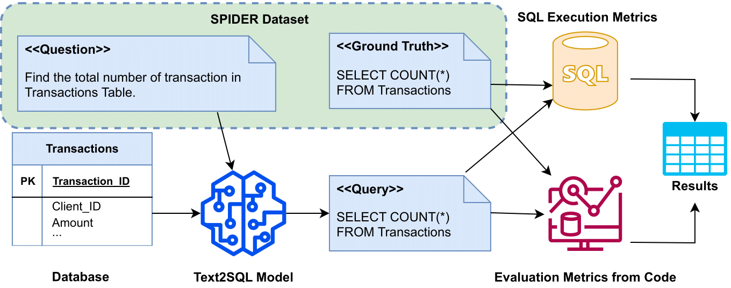
A Software Engineering Research Team’s Dive into FinTech
Context & Challenges: Databases & APIs
Text to SQL on LLMs
What we find and solved:
Find good LLMs for financial scenario
Solve how to evaluate SQL query when execution is not possible

Slide 36
LLM-RAG System
Clients
Agents
Chat-bot
Answer
Translator
Databases
API Callings
Documents
To make a functional chatbot system in the bank, we need:
The ability to reason and infer;
The ability to call API, SQL query and document retrieval;
The ability to format and filter results;
(Option) Integrate with a translator.

Slide 37
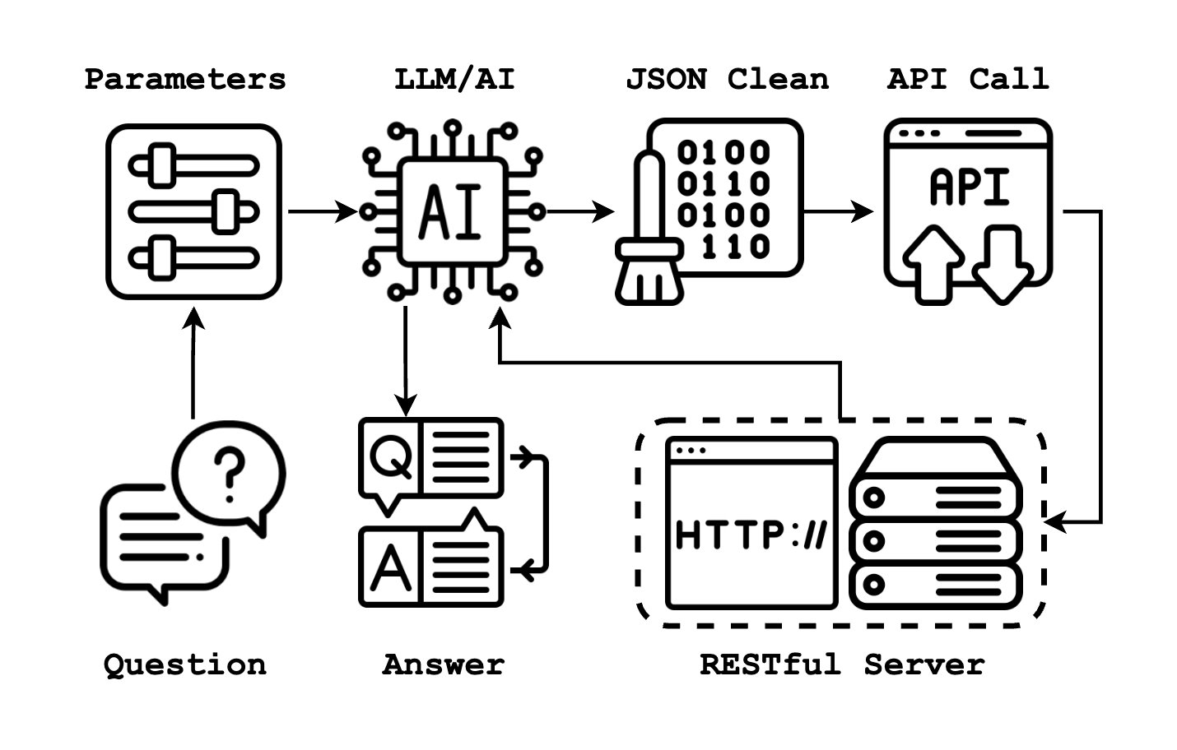
A Software Engineering Research Team’s Dive into FinTech
Context & Challenges: Databases & APIs
API Function Calling
LLM Can Do
Find retrieval solution for complex question;
Generate proper API calling message to send;
Intergrated with RAG system
We Proposed
One new evaluation dataset
Two prompt engineering approaches

Slide 38
LLM-RAG System
Clients
Agents
Chat-bot
Answer
Translator
Databases
API Callings
Documents
To make a functional chatbot system in the bank, we need:
The ability to reason and infer;
The ability to call API, SQL query and document retrieval;
The ability to format and filter results;
(Option) Integrate with a translator.

Slide 39





A Software Engineering Research Team’s Dive into FinTech
Retrieval Augmented Generation (RAG)
Traditional RAG
✅ Works well with text-heavy documents (e.g., legal contracts)
✅ Memory-efficient
❌ Limited ability to extract meaning from non-textual elements
Question + relevant
documents
Generate
answer
Ask
Question
Smart search
Large Language Model
(LLM)
Generated answer based
on provided documents
Smart
lookup
Relevant
documents
Specific (private) knowledge
base

Slide 40
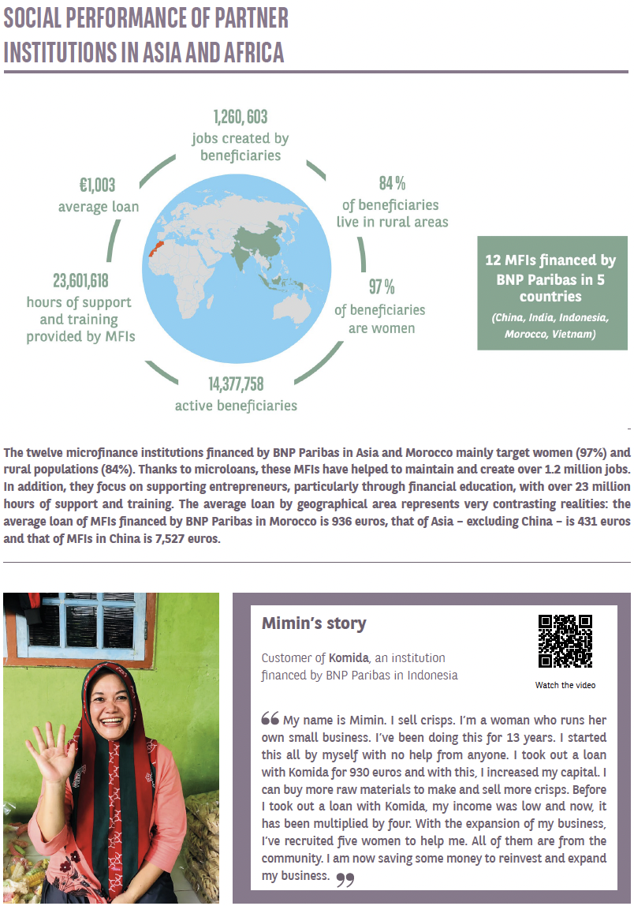

A Software Engineering Research Team’s Dive into FinTech
Solutions: Retrieval Augmented Generation (RAG)
Multimodal RAG
✅ Excels at handling visually rich documents
❌ Requires significant memory and computational resources
Vision-language
based RAG

Slide 41


A Software Engineering Research Team’s Dive into FinTech
Fruitful Collaboration
But! It was not easy at the beginning:
Should we invest time working in a new domain such as NLP?
It was not evident from the beginning
But it led to a fruitful collaboration
Allowed us to be at the forefront of NLP
We reused this knowledge to other tasks in Software Engineering
Actionable solutions for BGL BNP Paribas

Slide 42
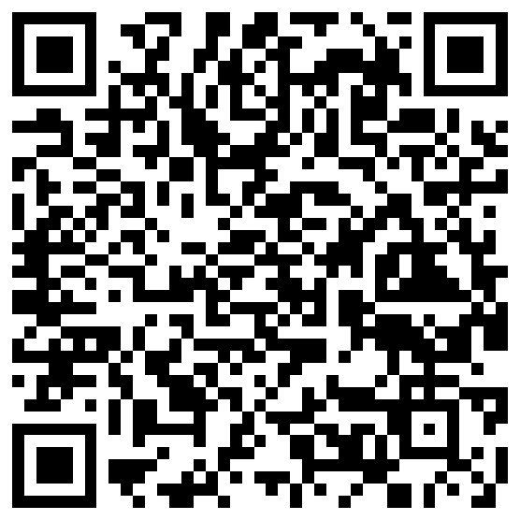
A Software Engineering Research Team’s Dive into FinTech
Dr. Jordan Samhi
Interdisciplinary Centre for Security, Reliability and Trust (SnT)

