Slide 1
Inequality and Happiness
Andrew E. Clark (Paris School of Economics and CNRS)
http://www.parisschoolofeconomics.com/clark-andrew/
[Partly based on Clark and D’Ambrosio (2015), Handbook of Income Distribution, Vol. 2A, Chapter 13]

Slide 2
This presentation is going to be about one thing that you think you know about …. because of this lecture series
- Income Inequality;
And subjective well-being, or happiness
What do we think the relationship might be?

Slide 3
W
I*
Inequality

Slide 4
Why this hump shape?
Because of incentive problems at low levels of inequality
And fairness issues at the top end

Slide 5
So holding the size of the pie to be shared constant:
W
Inequality
We have inequality aversion

Slide 6
There are then two key variables
- Income Inequality;
- And subjective well-being, or happiness;
You know what the first is.
But what is the second?

Slide 7
Satisfaction Questions
The BHPS/Understanding Society Question:
Here are some questions about how you feel about your life. Please tick the number which you feel best describes how dissatisfied or satisfied you are with the following aspects of your current situation.
Your life overall
[ 1 ] [ 2 ] [ 3 ] [ 4 ] [ 5 ] [ 6 ] [ 7 ]
not satisfied at all completely satisfied
This question is also asked about domains of life:
e.g. health, income, house, partner ...

Slide 8
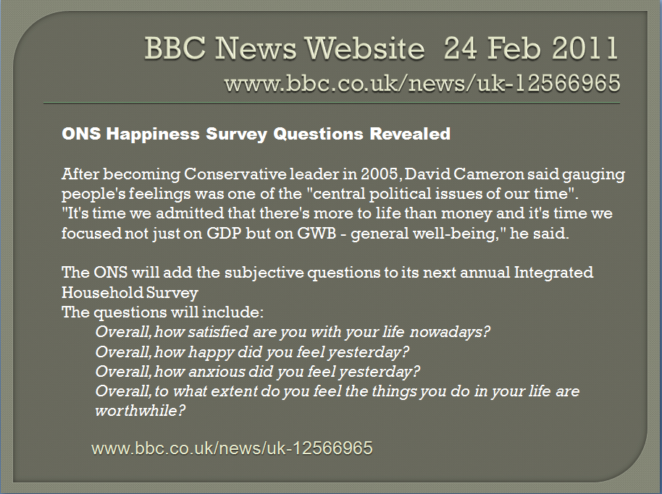
These “behave” the way we think that they should:
Notes:
1 – not satisfied at all
7 – completely satisfied

Slide 9
These are very often single-item measures (drives psychologists mad).
These provide democratic, not paternalistic, measures of well-being: it is you who decides what the good life is.
They are intuitively understood: there are few missing values
Despite their simplicity, they do seem to be picking up essential information about the quality of individuals’ lives

Slide 10
Cross-Rater Validity
If A is happy, then B is more likely to say that A is happy too: including A’s family, friends and the interviewer.
This generalises to people you don’t know: respondents shown pictures or videos of others accurately identify whether the individual shown to them was happy, sad, jealous, and so on.
10
Notes:
10
Also the self-reported measures correlate with certain physiological states (brain activty)
But empirical results differ depending on what outcome measure is used
e.g see the Borooah paper on the reading list
self-assessed happiness question
v. usage of tranquilisers and antidepressants
v. thoughts of self-harm (inc suicide)

Slide 11
Physiological and Neurological Evidence
There is a strong positive correlation between emotional expressions like smiling, and frowning, and answers to well-being questions
In right-handed people, positive feelings are generally associated with more alpha power in the left prefrontal cortex (the dominant brain wave activity of awake adults are called alpha waves), and negative feelings with more alpha power in the right prefrontal cortex (approach and avoidance).
Left-right brain asymmetry is shown to be associated with higher levels of positive affect, and with both hedonic and eudaimonic well-being
11
Notes:
11
Also the self-reported measures correlate with certain physiological states (brain activty)
But empirical results differ depending on what outcome measure is used
e.g see the Borooah paper on the reading list
self-assessed happiness question
v. usage of tranquilisers and antidepressants
v. thoughts of self-harm (inc suicide)

Slide 12
Brain asymmetry is also associated with physiological measures, such as cortisol and corticotropin releasing hormone (CRH)
These are involved in response to stress, and with antibody production in response to influenza vaccine.
12
Notes:
12
Also the self-reported measures correlate with certain physiological states (brain activty)
But empirical results differ depending on what outcome measure is used
e.g see the Borooah paper on the reading list
self-assessed happiness question
v. usage of tranquilisers and antidepressants
v. thoughts of self-harm (inc suicide)

Slide 13
Predicting Health Outcomes
High correlations in the expected sense between well-being scores and coronary heart disease, strokes, suicide and length of life.
The Nun Study: happier nuns when they joined a convent in the 1930s (textual analysis of biography) live longer.
Individuals with higher life satisfaction scores were less likely to catch a cold when exposed to a cold virus, and recovered faster if they did.
13
Notes:
13
Also the self-reported measures correlate with certain physiological states (brain activty)
But empirical results differ depending on what outcome measure is used
e.g see the Borooah paper on the reading list
self-assessed happiness question
v. usage of tranquilisers and antidepressants
v. thoughts of self-harm (inc suicide)

Slide 14
Predicting Labour Market Outcomes
In the labour market, job satisfaction at time t is a strong predictor of job quits (even when controlling for wages, hours of work and other standard individual and job variables).
Effort at work.
Reciprocity between workers and firms
Active sabotage
14
Notes:
14
Also the self-reported measures correlate with certain physiological states (brain activty)
But empirical results differ depending on what outcome measure is used
e.g see the Borooah paper on the reading list
self-assessed happiness question
v. usage of tranquilisers and antidepressants
v. thoughts of self-harm (inc suicide)

Slide 15
In general, SWB scores are “well-behaved”
Variables often associated with higher SWB:
being in employment
having good health
being married
being female
having higher income
(not) having children (?)
Mid-life crisis: being young; or being old
15
Notes:
15
Also the self-reported measures correlate with certain physiological states (brain activty)
But empirical results differ depending on what outcome measure is used
e.g see the Borooah paper on the reading list
self-assessed happiness question
v. usage of tranquilisers and antidepressants
v. thoughts of self-harm (inc suicide)

Slide 16
So subjective well-being measures make sense and uncover the relationships that we “think” that they should.
And of course we all believe in inequality measurement
Is well-being “well-behaved” with respect to income inequality too?

Slide 17
I used to think that this was a no-brainer question

Slide 18
I don’t any more…

Slide 19
1) A very simple model of inequality and happiness produces a simple answer:
Individual well-being is concave in income (an extra $1000 matters less for someone with $200 000 than for someone with $40 000)
The “social welfare function” (our overall index for how society is doing) rises with the sum of individual well-being
Then greater income inequality reduces social welfare (as we are taking income away from those who value it more)

Slide 20
Game over!
But can it really be that easy?

Slide 21
Inequality is a social phenomenon: it refers to disparities in incomes between individuals (i.e. there is income inequality when some individuals receive different incomes than do others).

Slide 22
2) We can have a dispassionate normative opinion about any distribution of income, which is independent of our own position in that distribution.
I can have an opinion about income distribution in Luxembourg
You can have an opinion about income distribution in Brazil
We can both have an opinion about the distribution of income in 19th Century Germany.

Slide 23
These “gut feelings” may well lead us to say that there is too much inequality too… (but we’ll come back this to think why)
Over and above our (correct) fixation on the diminishing marginal utility of income, we can then still conclude that inequality reduces subjective well-being, right?
Not finished yet though…

Slide 24
3) Most of the time, we also appear in the income distributions that are changing.
So: any change in incomes will affect not only my own income, but also the gaps between my income and the income of others in my society (to whom I compare) – my reference group.
This brings about a passionate response, as it were.

Slide 25
Changing income inequality affects not only how much income I receive (my absolute income), but also how much richer and poorer I am compared to others.
In this sense, we can think of the utility from income, as depending on not only my income but also the income of my reference group:
V = V(Y_{i}, Y_{i, ref})

Slide 26
We think in general that:
V = V(Y_{i}, Y_{i, ref})
+ -
An increase in income inequality that makes you richer (but not me) then makes me relatively poor (relative to you) and reduces my well-being
But the same increase in income inequality that makes you richer (but not me) makes you relatively rich (relative to me) and increases your well-being

Slide 27
Here, the rise in your income makes you richer in dollars, and you richer relative to everyone else.
But at the same time, this rise will make anyone who compares to you (for whom you are in their “reference group”) relatively poorer.

Slide 28
In general then, any change in the distribution of income will have many, many effects on our incomes relative to others, depending on:
the change in how much we earn;
the change in how much others earn;
to whom we compare (Everyone? Richer? Poorer?)

Slide 29
Let’s take all of this at face value.
The correlation between inequality and happiness will be
1) Negative via own income (concavity)
2) Negative? (but who knows) via normative evaluation (this depends on your views of fairness)
3) Ambiguous via comparisons to others, as it depends how your own income changes relative to that of your reference group.

Slide 30
The jury really is out.
The main culprit so far for this ambiguity is income comparisons: inequality implies changes in both absolute income, and relative income.
Life would be so much easier without the latter
So how do we know that income comparisons matter for individual happiness?

Slide 31
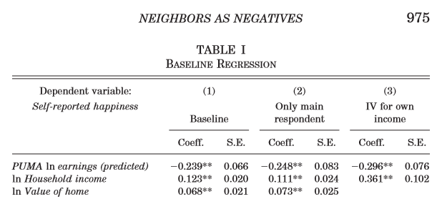
1) Happiness approach: Luttmer (2005) US National Survey of Families and Households
NB. Equal and Opposite

Slide 32
Clark (1996). BHPS (UK): very local comparisons
Estimated only on couples where both partners are in work. Includes other standard control variables.

Slide 33
2) Ask people. Preference for rising income profiles, and preferences for lower absolute incomes:
A: Your current yearly income is $50,000; others earn $25,000.
B: Your current yearly income is $100,000; others earn $200,000.
Individuals have a marked preference for A over B.
Positionality differs according to the domain. In Alpizar et al. (2005) this is stronger for cars and housing, and weaker for vacations and insurance.

Slide 34
3) Experimental.
In the ultimatum game (where I essentially propose free money to you) responders frequently reject offers that are under 25% of the total sum; as such the the vast majority of offers are between 40% and 50% of the sum.

Slide 35
Zizzo and Oswald (2001) report the results of an experiment whereby subjects can pay to burn each other’s money. A majority of subjects chose to do so, even though it costs them real earnings. The average subject had half of her earnings burnt, and richer subjects were burnt more often.

Slide 36
4) Natural Experiments Card et al. (2012): the revelation of information on others' earnings. The natural experiment here is a court decision that made the salary of any California state employee public knowledge. A local newspaper set up a website making it easy to find this information. Following this website launch, Card et al. informed a random subset of employees at three UC campuses about the site.

Slide 37
Some days later, all employees on the three campuses were surveyed. Compare the treatment group (informed about the website) to others to reveal the impact of information on others' salaries. The reference group was defined here as co-workers in the same occupation group (faculty vs. staff) and administrative unit in the university.

Slide 38
The survey found lower job satisfaction for those with pay below the reference group median and a greater intention to look for a new job. The effect on both for those who were relatively well-paid was insignificant. There is some evidence of an actual quitting effect on those who were found to be in the bottom earnings quartile in the reference group.

Slide 39
This is not a banal effect of “low pay leads to lower satisfaction and greater quits”. Pay in the treated and untreated groups is the same. The treated group are instead more likely to find out that they are relatively badly-paid

Slide 40
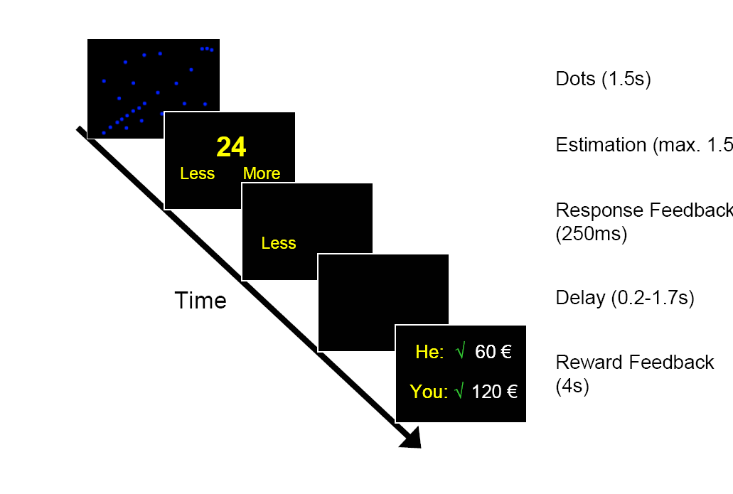
5) Neuro. Fließbach, K., Weber, B., Trautner, P., Dohmen, T., Sunde, U., Elger, C., & Falk, A. (2007). "Social comparison affects reward-related brain activity in the human ventral striatum". Science, 318, 1305-1308.

Slide 41
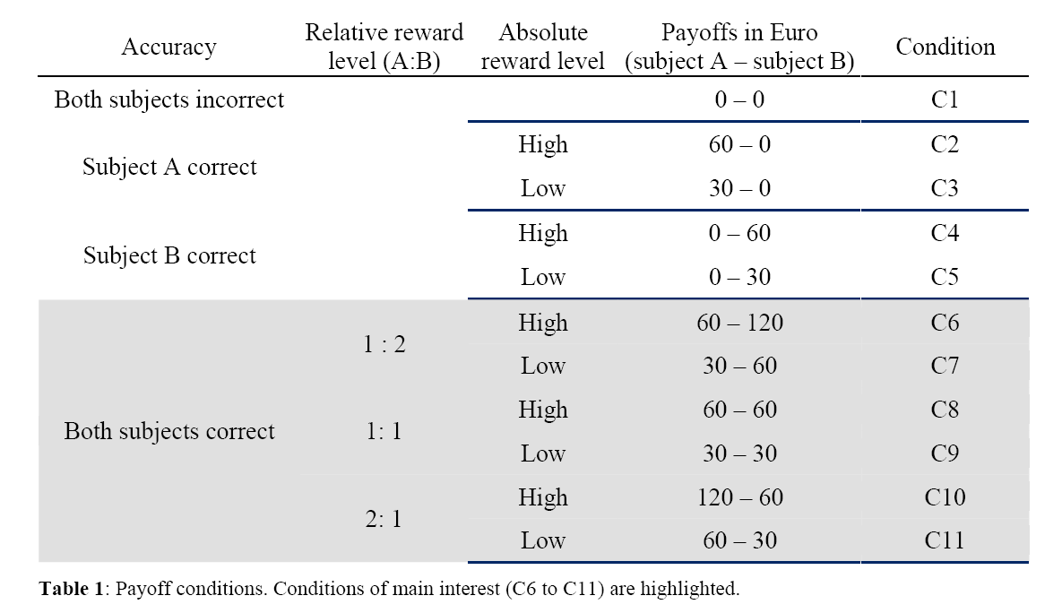
Payoffs vary according to whether the individual gets the task right, and also randomly when the task is correct

Slide 42
Brain activity measured via BOLD blood flow in various voxels.
Particular attention paid to the ventral striatum: the “neural circuitry of reward”
This kind of striatal activity has been shown to predict both hedonic outcomes (subjective well-being) and physiological outcomes (cortisol output: the body’s response to stress)

Slide 43
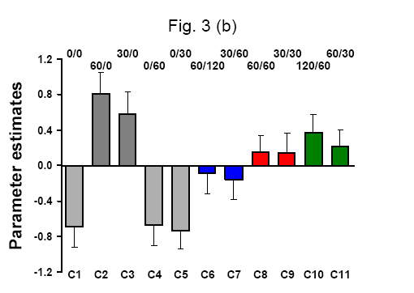
Brain activation depends on relative income: compare C6, C8 and C11 (where the individual receives 60 Euros), and C7 to C9.

Slide 44
A variety of types of evidence then suggest that income comparisons exist.
So that inequality will affect well-being via relative income

Slide 45
What do we know about normative evaluations of inequality?
What do people say about the overall degree of income inequality, without making any comparisons to others?

Slide 46
Experimental attitudes to inequality
1) Trade off level of income to inequality of income:
The “hypothetical grandchild”;

Slide 47
The well-being of imaginary grandchilden in alternative societies which are characterized by different uniform income distributions (e.g., Society A ranges from 10,000 to 50,000 Swedish kroner, but Society B from 19,400 to 38,800 Swedish kroner).
Expected income higher in Society A
Choose the society that is best for your grandchild.
Respondents were also told that they did not know their grandchild’s position in the income distribution, and that they should place equal probability on all outcomes.

Slide 48
The more inequality-averse the individual is, the more they are willing to trade-off expected income in order to achieve a more equal income distribution.
Individuals do exhibit a considerable amount of inequality aversion in these experiments

Slide 49
2) Do people even agree with the basic axioms of inequality measurement? Test the Pigou-Dalton transfer principle. The seminal book is this area is Amiel and Cowell (1999).
Verbal experiment:
“Suppose we transfer income from a person who has more income to a person who has less, without changing anyone else’s income. After the transfer the person who formerly has more still has more.”
60% agree that this reduces inequality.

Slide 50
Numerical experiment:
Consider two income distributions:
Society A = (l, 4, 7, 10, 13)
Society B = (l, 5, 6, 10, 13).
Only 1/3 agree that Society B is more equal than Society A (even though the “transfer” between the two corresponds to the Pigou-Dalton principle)
Individuals think of falling income inequality in Robin Hood terms (and perhaps also of rising inequality in Sheriff of Nottingham terms)

Slide 51
What is then the sum total of own income, income comparisons, and the normative evidence?
Inequality and well-being
There are many equations estimated such as:

Slide 52
Ineq here is almost always Gini.
Table 1 in our chapter provides a representative sample of estimation results for γ above.
There are 27 rows:
In 14 γ is < 0
In 5 it is > 0
In 6 it is = 0
In one we don’t know
And in the last, it is both positive and negative.
Probably fair to say that this is inconclusive (and beware of the Moulton correction!).

Slide 53
This empirical ambiguity is unsurprising if we believe that the correlation picks up the effect of own absolute income, own relative income and “pure” (normative) attitudes to income inequality.

Slide 54
Note 1
Is the Gini the “best” measure of the distribution for the normative evaluation? Gini moves relatively little over time, making multicollinearity a distinct possibility in cross-country work.
Others are possible, such as the income share of the top quintile, D9/D1, p95/p50, the percentage in poverty, or even rank in the income distribution.
Most applied work doesn’t compare distribution measures

Slide 55
Note 2
Fairness and perceptions.
Above measures of income are objective: they measure what others in the society actually earn. This is of course not necessarily what individuals believe that others earn.
And their beliefs may not be correct

Slide 56
How good is your perception of your home country’s income distribution?
The OECD's new web-tool Compare your income allows you to see whether your perception is in line with reality. In only a few clicks, you can see where you fit in your country's income distribution.
http://www.oecd.org/statistics/compare-your-income.htm
[Not telling you how well I did]

Slide 57
Note 3.
To whom do we compare?
Almost all of the survey literature assumes that everyone compares to everyone.
In the experimental literature, which can manipulate such things, comparisons to people richer than you matter more than comparisons to those poorer than you.
And we may well be altruistic with respect to some others.

Slide 58
Note 4.
Other outcome measures. We have looked at SWB and the desire to redistribute.
Other intriguing work has highlighted significant empirical correlations between (almost always) the Gini coefficient and:
Agreeableness (Big Five): -

Slide 59
Note 5.
Other outcome measures. We have looked at SWB and the desire to redistribute.
Other intriguing work has highlighted significant empirical correlations between (almost always) the Gini coefficient and:
Agreeableness (Big Five): -
Trust: -

Slide 60
Note 5.
Other outcome measures. We have looked at SWB and the desire to redistribute.
Other intriguing work has highlighted significant empirical correlations between (almost always) the Gini coefficient and:
Agreeableness (Big Five): -
Trust: -
Political Participation: -

Slide 61
Note 5.
Other outcome measures. We have looked at SWB and the desire to redistribute.
Other intriguing work has highlighted significant empirical correlations between (almost always) the Gini coefficient and:
Agreeableness (Big Five): -
Trust: -
Political Participation: -
Support for globalisation: -

Slide 62
Note 5.
Other outcome measures. We have looked at SWB and the desire to redistribute.
Other intriguing work has highlighted significant empirical correlations between (almost always) the Gini coefficient and:
Agreeableness (Big Five): -
Trust: -
Political Participation: -
Support for globalisation: -
Violent behaviour: +

Slide 63
Note 5.
Other outcome measures. We have looked at SWB and the desire to redistribute.
Other intriguing work has highlighted significant empirical correlations between (almost always) the Gini coefficient and:
Agreeableness (Big Five): -
Trust: -
Political Participation: -
Support for globalisation: -
Violent behaviour: +
Self-enhancement: +

Slide 64
Note 5.
Other outcome measures. We have looked at SWB and the desire to redistribute.
Other intriguing work has highlighted significant empirical correlations between (almost always) the Gini coefficient and:
Agreeableness (Big Five): -
Trust: -
Political Participation: -
Support for globalisation: -
Violent behaviour: +
Self-enhancement: +
Female Preferences for facial masculinity: +

Slide 65
Note 5.
Causality?
Let’s just say that this has been treated in a pretty cavalier fashion in this literature.
Changes in income happen for a reason: could be that it is this reason that affects well-being, not income inequality as such.
Or that happiness causes inequality, rather than inequality causing happiness.
So all we need is an exogenous movement in the income distribution…

Slide 66
If only…
There is interesting work on the minimum wage.
Support for minimum-wage rises highest amongst minimum wage workers.
And lowest amongst those who earn just above the minimum wage (last-place aversion).
[Kuziemko, I., Buell, R., Reich, T., and Norton, M. (2014). "“Last-Place Aversion”: Evidence and Redistributive Implications". Quarterly Journal of Economics, 129, 105-149.]

Slide 67
Final thoughts.
There is no doubt that feelings of unfairness are a catalyst for well-being and behavior.
This is something that we can observe currently.
Are our objective measures of inequality the right ones?
How are perceptions related to objective outcomes?

Slide 68
Final thoughts.
Do we need a policy for distribution, or a policy for the perception of distribution?
And if comparisons make us unhappy, can we learn to compare less?

