Slide 1
Inequality and the Art Market
Andrés Solimano
International Center for Globalization and Development (CIGLOB)
Inequality and…?, lecture series, Luxembourg
June – 2019.

Slide 2
Motivation
Art in times of high wealth creation (concentrated at the top), uncertainty, macro crises, trade-wars, de-globalization.
The strong irruption of the global art market (paintings, sculptures, prints, drawings, artifacts): annual sales of 67 billion dollars and rising (2018). .
Art as a refuge to financial and geopolitical turbulence?
Dual role of artwork: aesthetic enjoyment and investment asset.
Declining public support for the arts.
Influence of big money/wealth on the art market.
Extravagant prices (Koons, Da Vinci, Monet, Hockney).
Market- segmentation, big sales in large auction houses/large galleries but quantities in middle size-small galleries.

Slide 3
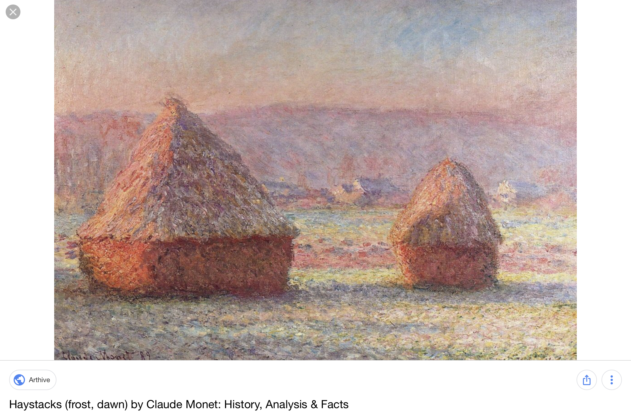
Monet’s Haystack (sold, USD 110 million).

Slide 4
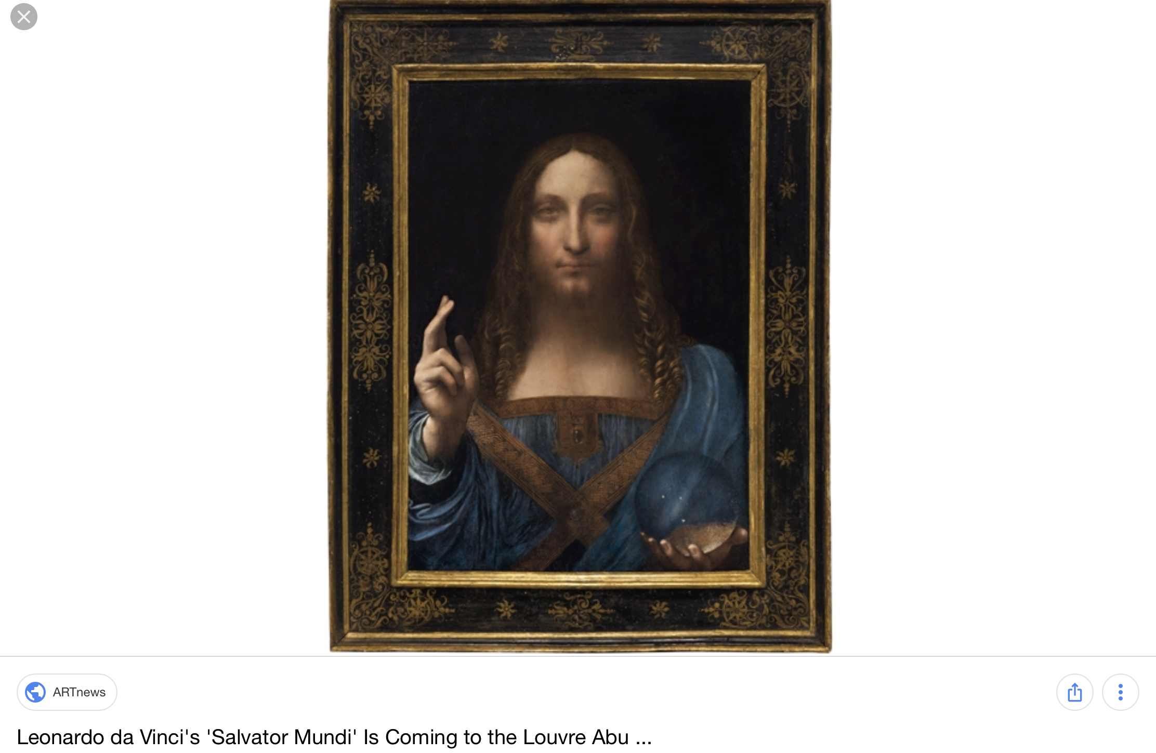
Da Vinci ‘s “ Salvatore Mundi” (sold, USD 450 million)

Slide 5
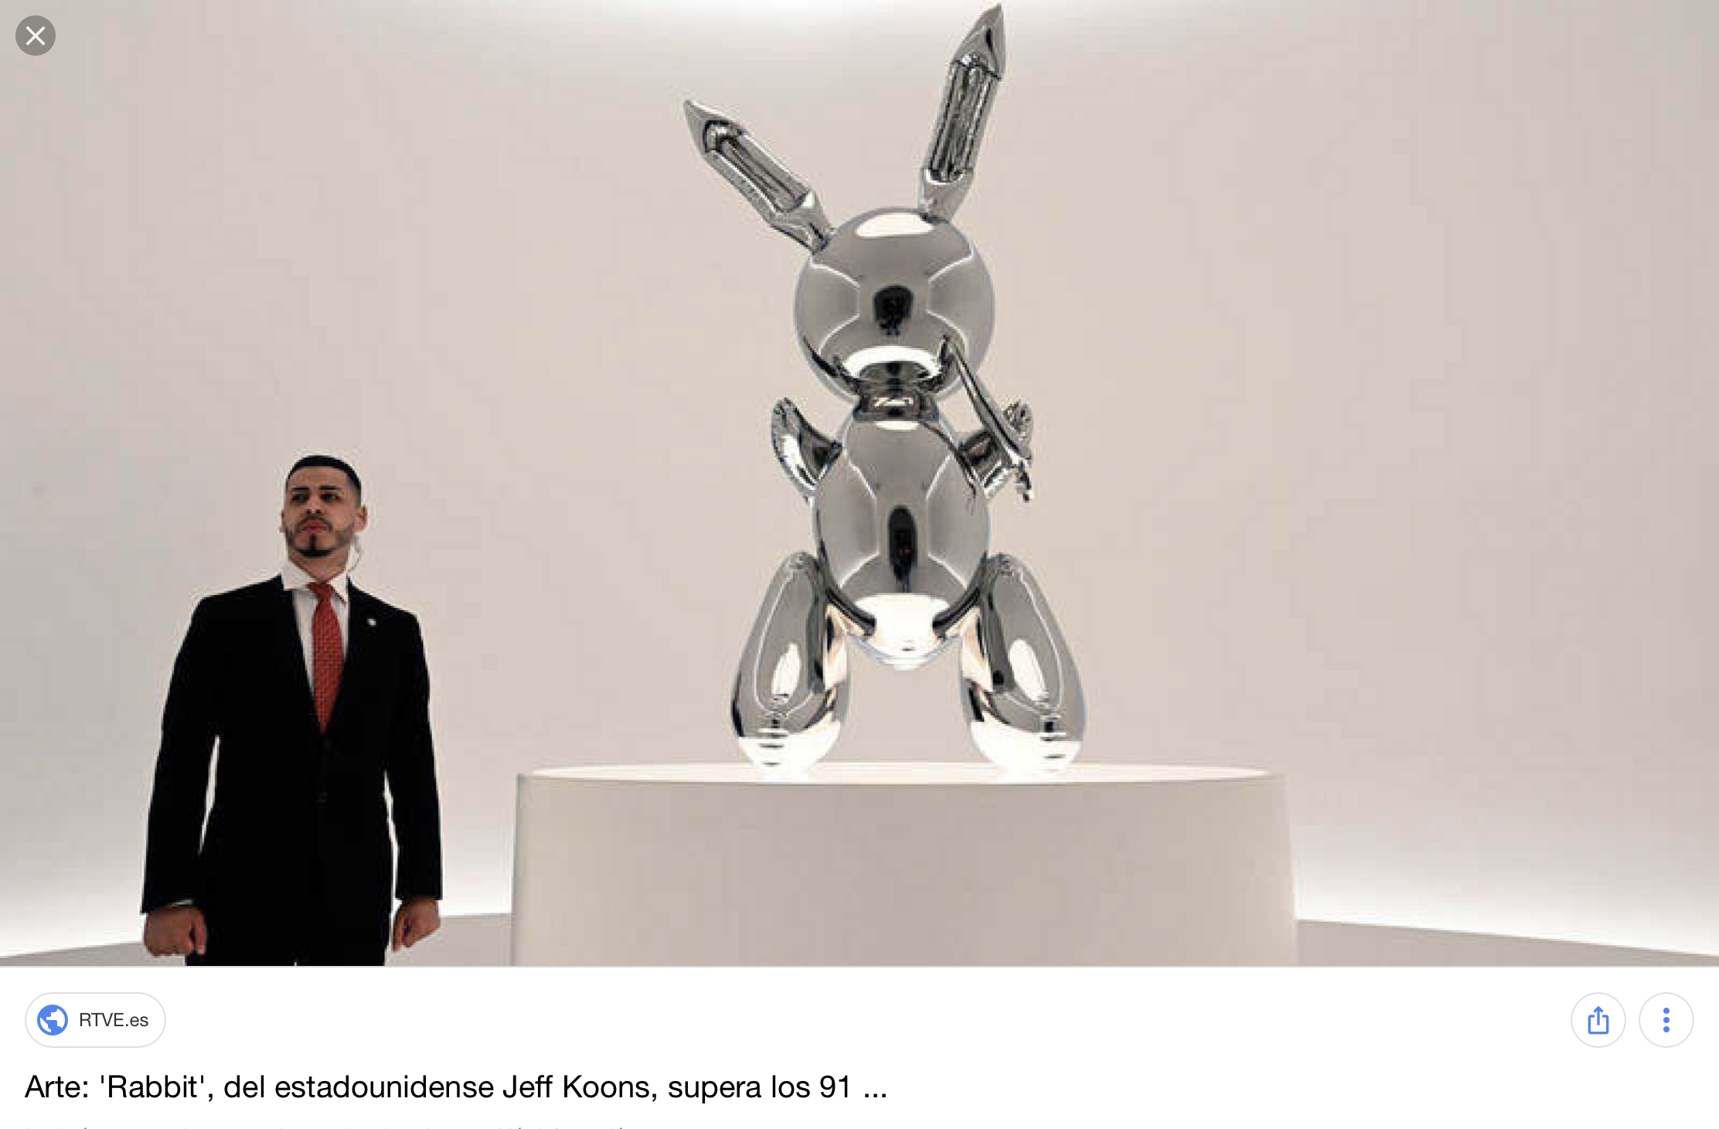
Jeff Koons (living artist)’s “Rabbit” (sold, USD 91 million)

Slide 6
Motivation (cont.)
Macroeconomic cycles and financial crises (e.g 2008-09) and the art market .
Is art a “safe-heaven” asset?
Does art rise the value of portfolios in bad times ?
Wealth shocks and the demand for art.
Valuation conundrums.

Slide 7
Themes of the Presentation
A. Main Features of the Art Market.
B. Art Prices During Macroeconomic Cycles and Financial Crises.
Stocks and Gold.
Safe-havens.
Historical Evidence and Correlation Analysis.
C. Wealth Inequality and the Art Market.

Slide 8
A. Seven Features of the Art Market
Transaction costs and liquidity.
Privatization and Financialization.
Concentration and Polarization.
Sensitivity to macroeconomic cycles and crises.
Lack of regulation, tax avoidance/elusion, money laundering.
Increasingly globalized market: main players (USA, UK, China).
Niche market influenced by high wealth concentration at the top.

Slide 9
(i) Transaction costs and liquidity.
Art objects are unique and heterogeneous.
Cost of finding buyers.
Forgery and provenance issues.
Masterpieces have infrequent sales.
All this makes transactions costs non-trivial.
The ability of a collector or buyer to convert a piece of art into money can be limited. This is a market with potential lack of liquidity.

Slide 10
(ii) Privatization and Financialization
Growing private ownership of artwork of high-value. How affects public museums?.
The art market is increasingly financialized with art becoming a vehicle of investment — a new asset-class.
Hedge funds, family offices, art investment funds, commercial banks all interested in investing in art. Knowledge needs.
Average rate of return from trading in artworks does not differ, substantially, from the return of holding stocks or bonds once adjusted by risk premiums. The Keynes collection study.

Slide 11
(iii) Concentration and Polarization
Share of Lots Sold and Total Value at Global Fine Art Auctions in 2017 by Price Bracket.
 | Value | Volume
Lower-end (Below $50k) | 8.6% | 89.8%
Middle Market ($50k - $1m) | 27.9% | 9.4%
High-end (Above $1m) | 63.5% | 0.9%
Total | 100.0% | 100.0%
The bulk of the number of transactions –volume- is concentrated at the lower-end of the market, while the bulk of sales value is concentrated at the higher-end of the market.
The auction segment of the market, now accounts for almost half of the total fine art sales in 2017—$28.5 billion of $63.7 billion (McAndrew, 2018, 16).
The upper-end of the art market is characterized by highly personal relations and rather obscure practices regarding price and fee
Source: McAndrew, C. (2018).

Slide 12
(iv) Sensitivity to macroeconomic cycles
The Global Art Market: Value and Volume of Transactions,2008-2018
The aggregate evidence suggests the art market tends to behave in a pro-cyclical way, with total sales/volumes rising in the upswings, and declining in the downturns of the business cycle.
Upward and downward cycles can affect differently the various segments of the art market.
Source: Table 1, McAndrew (2019)

Slide 13
(v) Lack of Regulation, Tax Avoidance/ Tax Elusion, Money Laundering.
Weak regulation of the art market.
Little protection to buyers from manipulative practices.
Freeports: Top collectors are increasingly buying artwork as investments to reduce their tax burden.
Money-laundering through acquisition of art?

Slide 14
(vi) The art market is increasingly globalized
Global Art Market Share by Value in 2018
The US, UK and China concentrate over 80 percent of total sales in art followed by France, Germany and Switzerland.
In the 1970s and 1980s, the Asian regional art market started to rise. First, conducted by Japan and nowadays, by China.
Source: Art Market 2019

Slide 15
(vii) The Art Market is Influenced by Wealth Inequality
Number and Wealth of Dollar Millionaires 2010–2018
The evidence shows the growth of the art market and the predominance of its upper-end has coincided with the rapid increase in the number of wealthy people and the growth in their assets in the world economy
Source: Art Market 2019

Slide 16
B. Art Prices, Stocks and Gold in Macro Cycles and Financial Crises (1998-2018, quarterly)

Slide 17
Art Prices in the 1998-2018 cycle.
Pre crisis increase (T/P) | Change, %
(1998Q1-2008Q1) | 64.6
Crisis correction (P/T)
(2008Q1- 2009Q4) | -39.6
Recovery/Boom (T/P)
(2009Q4- 2011Q3) | 77.0
New correction (P/T)
(2011Q3-2018Q4) | -53.0
————————————————
Note: T= Trough, P=Peak. Elaboration from series from Artprice.com in real dollars of 2015 Q4, deflated by US CPI.

Slide 18
Stock Prices (S&P 500) in the 1998-2019 Cycle.
Pre-crisis increase (T/P) | Change, %
1998(Q1)- -2007(Q3) | 14.2
Crisis correction (P/T)
2007(Q3)- 2009(Q1) | -47.0
Post-crisis recovery/boom (T/P)
2009(Q1) – 2018(Q3) | 197.0

Slide 19
Gold Prices in Three Crisis: Great Depression (1930s), Stagflation (1970s) and Global Financial Crisis (2008-09).
 | Real Price (USD per ounce) | Ratio peak/trough and percent change
Great Depression of the 1930s
1920 (6) | 235.15 | 1.19 (19%)
1929 (9) | 281.23
1929 (12) | 282.87 | 2.18 (118%)
1934 (2) | 617.93
Stagflation of the 1970s
1970 (12) | 215.7 | 9.48 (848%)
1980 (1) | 2,046.0
Global Financial Crisis of 2008-09
2001 (3) | 350.5 | 5.39 (440%)
2005 (8) | 523.58
2008 (3) | 1,064.96
2011 (8) | 1,891.60
2014 (11) | 1,176.04

Slide 20
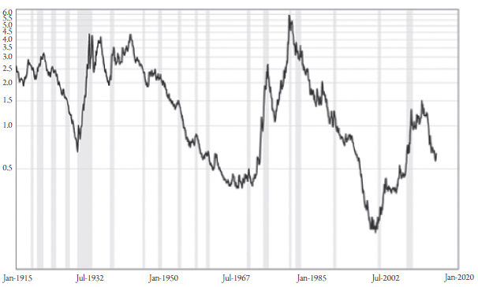
A Century of the Ratio of Gold Prices to Stock Prices, 1914-2015.

Slide 21
Is Art a Safe-Haven Asset?
A safe haven asset/investment is one that its price (or rate of return) is either uncorrelated or negatively correlated with other assets of a portfolio.
Historical evidence of cycles shows that:
Art prices (aggregate indices) are pro-cyclical.
Stock prices are pro-cyclical.
Gold prices are counter-cyclical, a safe-haven asset.
Correlation analysis.

Slide 22
Price correlations
Correlation Matrix between Art Prices, Financial Assets and Commodities (real prices, first quarter of 1998 to second quarter of 2018)
 | Nikkei 225 | S&P 500 | Gold | Oil | Art Price Global Index (USD) | Art Price Global Index (EUR) | FTSE China A50 ^{A} | MSCI World Historical Data ^{A} | Bitcoin ^{B}
Nikkei 225 | 1
S&P 500 | 0.71 *** | 1
Gold | -0.44 *** | 0.1 | 1
Oil | -0.5 *** | -0.19 * | 0.74 *** | 1
Art Price Global Index (USD) | -0.33 *** | -0.37 *** | 0.29 *** | 0.7 *** | 1
Art Price Global Index (EUR) | -0.01 | -0.15 | -0.24 ** | 0.1 | 0.54 *** | 1
FTSE China A50 ^{A} | 0.14 | -0.04 | 0.04 | 0.21 | 0.19 | 0.19 | 1
MSCI World Historical Data ^{A} | 0.88 *** | 0.91 *** | -0.14 | -0.24 * | -0.24 * | 0.09 | 0.1 | 1
Bitcoin ^{B} | 0.59 *** | 0.68 *** | -0.3 * | -0.33 * | -0.11 | -0.51 *** | -0.54 *** | 0.69 *** | 1
The evidence is not entirely conclusive for all indices but we can detect a negative correlation (significant at 99%) between the real global art price index and two stock market indices: the real Nikkei 225 and the real S&P 500.
At the same time the global art market price index (in USD) has a positive correlation with gold prices.
Significance (99%)*** p<0.01, signficance (95%) ** p<0.05, * significance 90%( p<0.1).
A : Correlation are calculated from 2004Q4
B : Correlations are calculated from 2010Q3

Slide 23
C. Wealth Inequality and the Art Market
Wealth distribution within countries.
Wealth distribution between countries.
Wealth shocks and the art market.

Slide 24
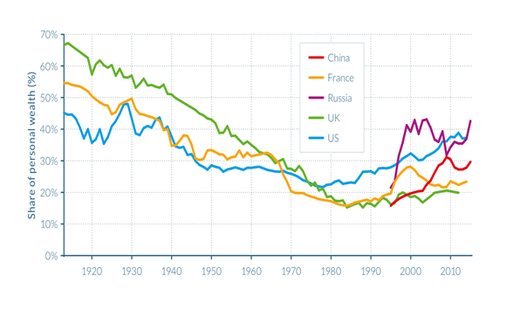
Wealth Share of the top 1 percent in Five Main Economies.

Slide 25
Number and Wealth of Millionaires, 2010-2018

Slide 26
Global Share of Millionaires with Wealth in Excess of $50 Million in 2018 (USA and China dominate, they are also the main art markets)

Slide 27
Art and Wealth Shocks
Recession-led decline in asset prices and wealth reduces the demand for artworks.
Are Masterpieces resilient to adverse wealth shocks?
Are artworks a “safe-haven”?
Wealth concentration at the top and market segmentation (niche market for artwork of high value).
Positive correlation between the number and stock of wealth of millionaires and billionaires and the price of artwork

